Slide 1


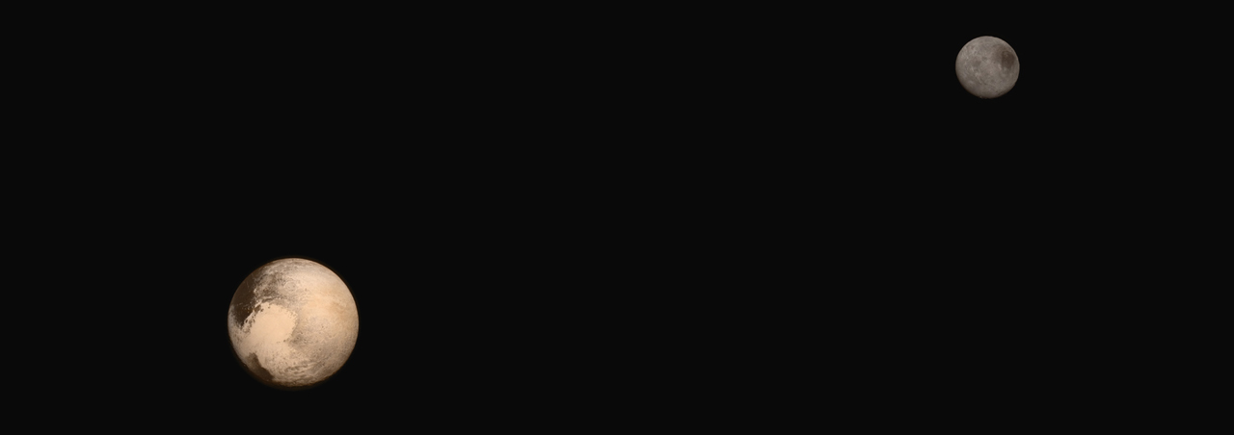
Dr. Leslie Young, EAPS '94
Southwest Research Institute
Deputy Project Scientist for
NASA's New Horizons
Mission to Pluto
New Horizons at Pluto:
Encounter Science and Operations
International Space Development Conferences
2016 National Space Society Meeting, May 21, 2016
San Juan, Puerto Rico
Notes:
Pluto and it's moons as

Slide 2
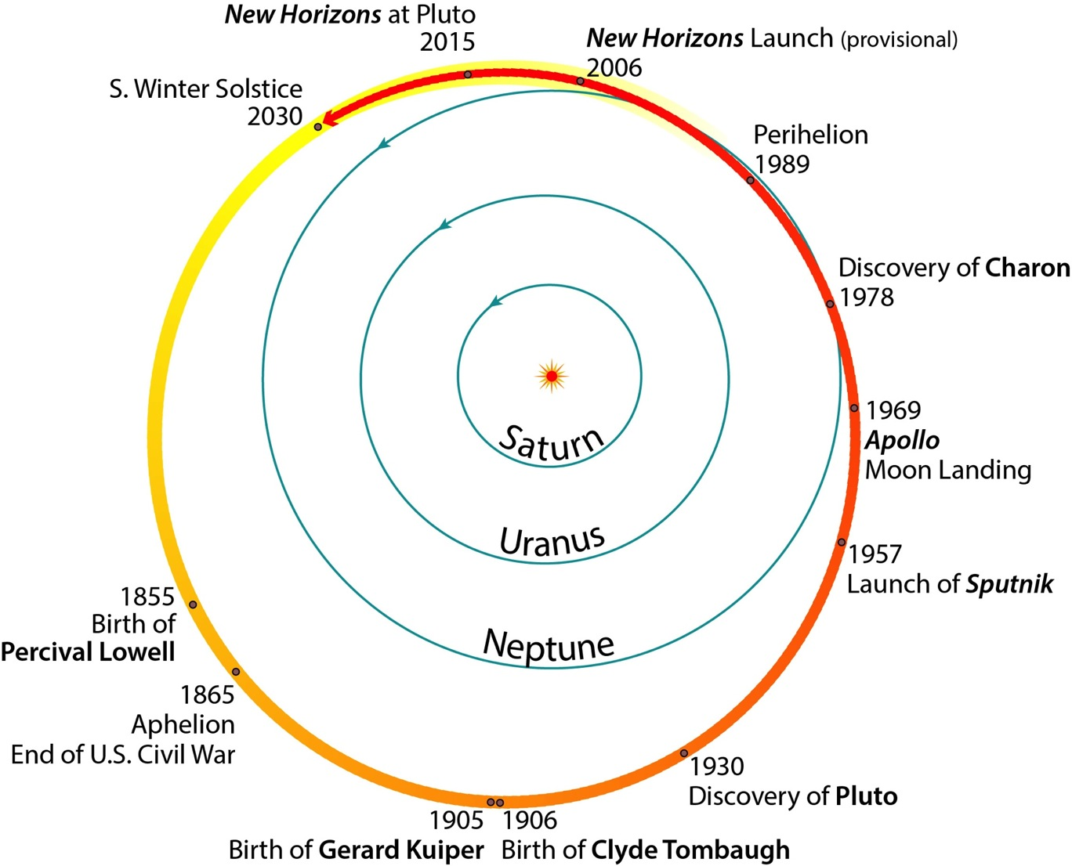
Pluto orbits the Sun every 248 years
Notes:
8

Slide 3
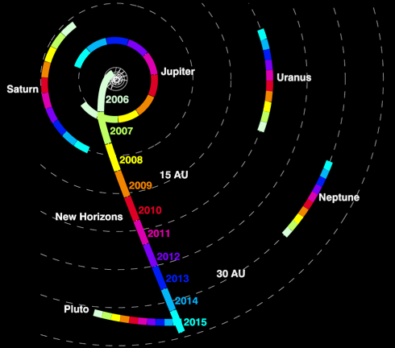
Headed for 2014MU69, July 1, 2019
Notes:
Traveling on average 14 km/s (31,000 mph, 49,881 km/h), New Horizons covers about 1.2 million km/day (740,000 miles/day), 3 AU a year.
Launched: January 19, 2006
Lockheed Martin Atlas V-551 (core Atlas booster [with five solid rocket boosters attached] with a Centaur upper stage); and a Boeing STAR-48B solid-propellant rocket third stage.
Jupiter Gravity Assist: Feb 28, 2007
Crossed Saturn’s orbit: June 8, 2008
Crossed Uranus’ orbit: March 18, 2011
Crossed Neptune’s orbit: August 25, 2014
Pluto-Charon Encounter: July 14, 2015
SWAP/PEPSSI all the way out – just published in ApJ Supp.

Slide 4
Elliott et al 2016. The ApJSup 223, 19
Headed for 2014MU69, Jan 1, 2019
Notes:
Traveling on average 14 km/s (31,000 mph, 49,881 km/h), New Horizons covers about 1.2 million km/day (740,000 miles/day), 3 AU a year.
Launched: January 19, 2006
Lockheed Martin Atlas V-551 (core Atlas booster [with five solid rocket boosters attached] with a Centaur upper stage); and a Boeing STAR-48B solid-propellant rocket third stage.
Jupiter Gravity Assist: Feb 28, 2007
Crossed Saturn’s orbit: June 8, 2008
Crossed Uranus’ orbit: March 18, 2011
Crossed Neptune’s orbit: August 25, 2014
Pluto-Charon Encounter: July 14, 2015
SWAP/PEPSSI all the way out – just published in ApJ Supp.

Slide 5
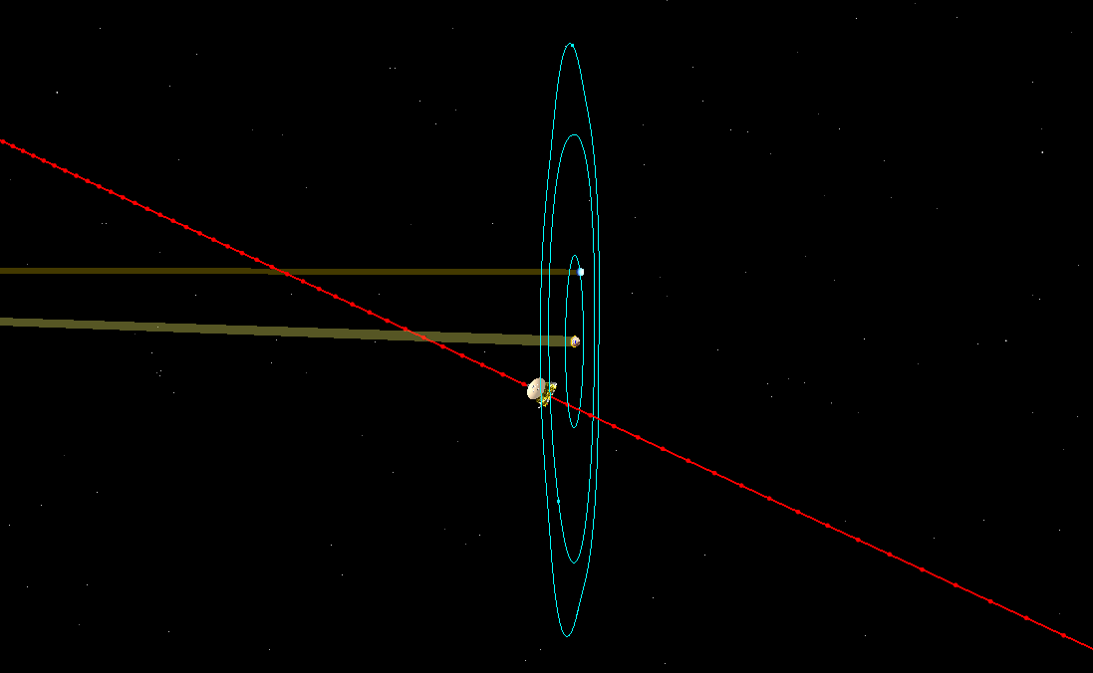
The Flyby: July 14, 2015
The spacecraft crossed through in a few hours
Hydra
Hydra C/A
11:59:51
77,471 km
Charon-Earth
Occultation
14:20:02
Times in UTC
Distance from surface
Pluto-Earth
Occultation
12:51:00
Charon
Sun
Earth
Pluto
0.24°
Charon-Sun
Occultation
14:17:43
Pluto-Sun
Occultation
12:49:58
Charon C/A
12:02:23
28,825 km
Kerberos C/A
12:12:49
68,948 km
Pluto C/A
11:48:29
12,490 km
Nix
New Horizons Trajectory
Nix C/A
11:11:48
22,067 km
Styx C/A
12:26:47
39,123 km

Slide 6

https://www.youtube.com/watch?v=ds_OlZnV9qk&feature=youtu.be
Notes:
2:01

Slide 7
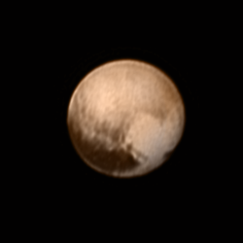
First Image in CORE Load
Image taken July 7, received July 8, 2015
Notes:
Data taken July 7, 22:46 SC UT = 23:01 EDT.
I drove in at 4:45 AM this morning to sit in the Navigation area and see this morning's image come in. This image was special. It was the first image after the weekend's terrifying hiccup, when the spacecraft said "I just can't deal with all this," turned off all the instruments, and pointed to Earth. Ops worked hard all weekend, and we'd been seeing information from the spacecraft that things were fine, that the spacecraft was happy, and that the commands were going as planned. This image cinched it. This image proved that the spacecraft was actually taking the pictures of Pluto we wanted, storing them, and sending them down.

Slide 8

First Image in CORE Load
Image taken July 7, received July 8, 2015

Slide 9
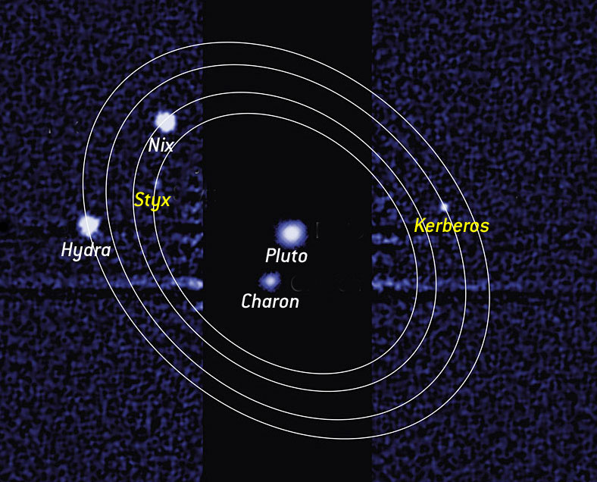

Slide 10
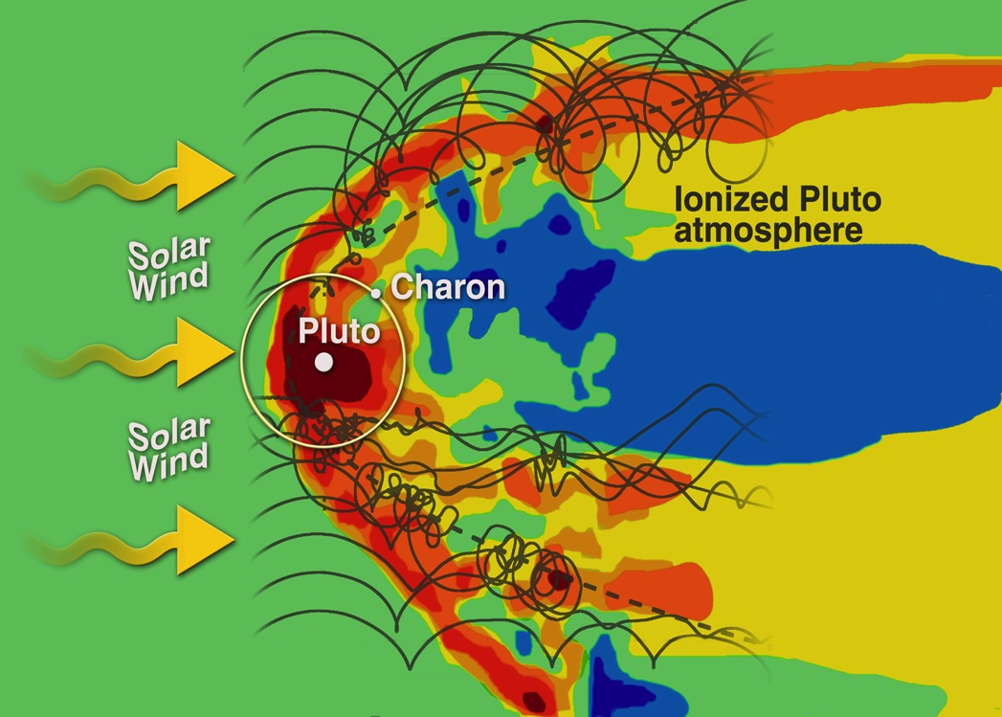
Pluto System

Slide 11
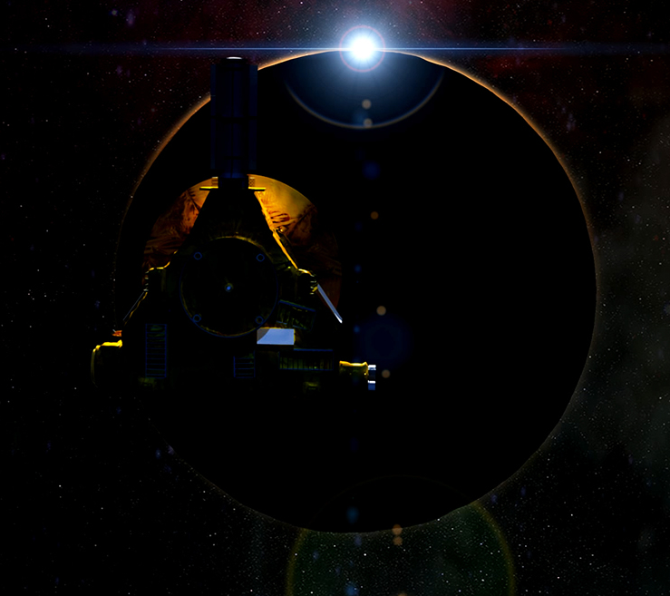
Pluto System

Slide 12
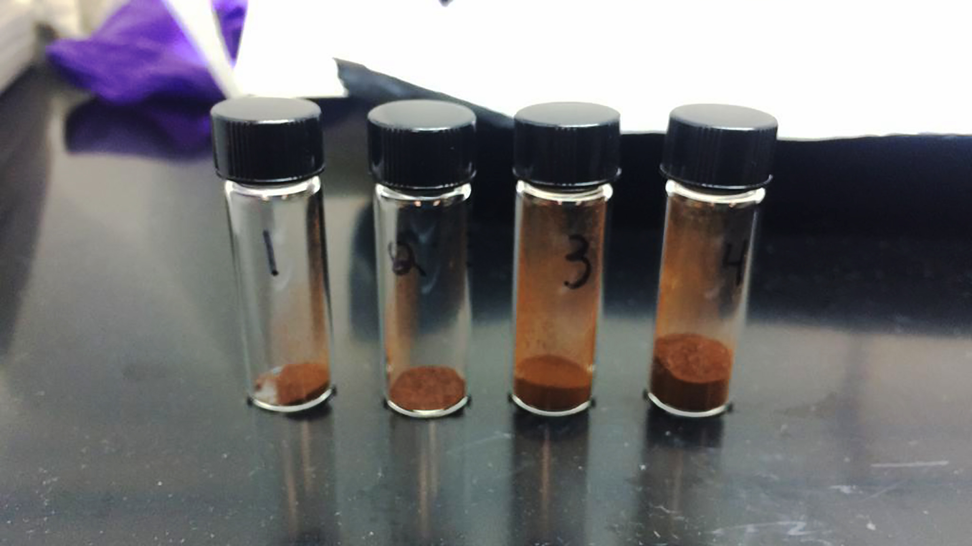
Pluto System

Slide 13

Pluto System

Slide 14
Pluto and its Five Moons

Slide 15
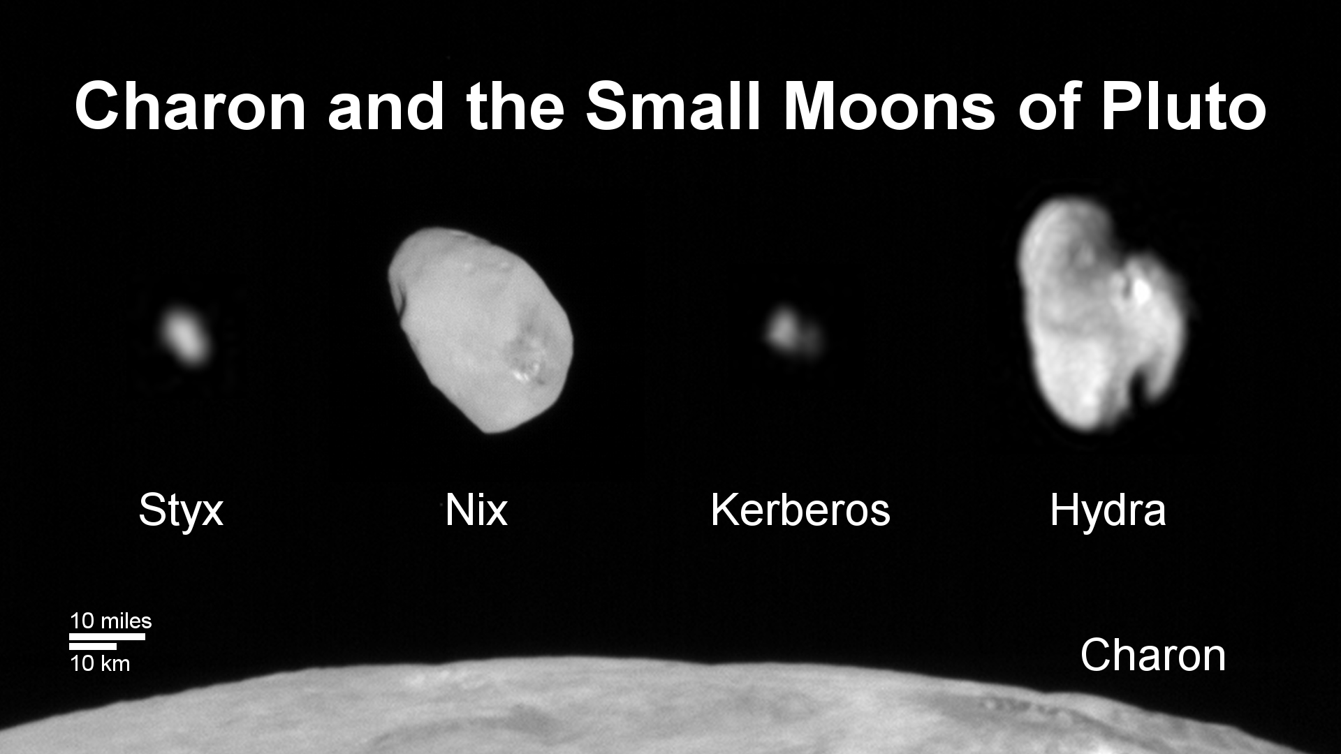
Weaver et al. 2016. The small satellites of Pluto as observed by New Horizons. Science 351, aae0030

Slide 16
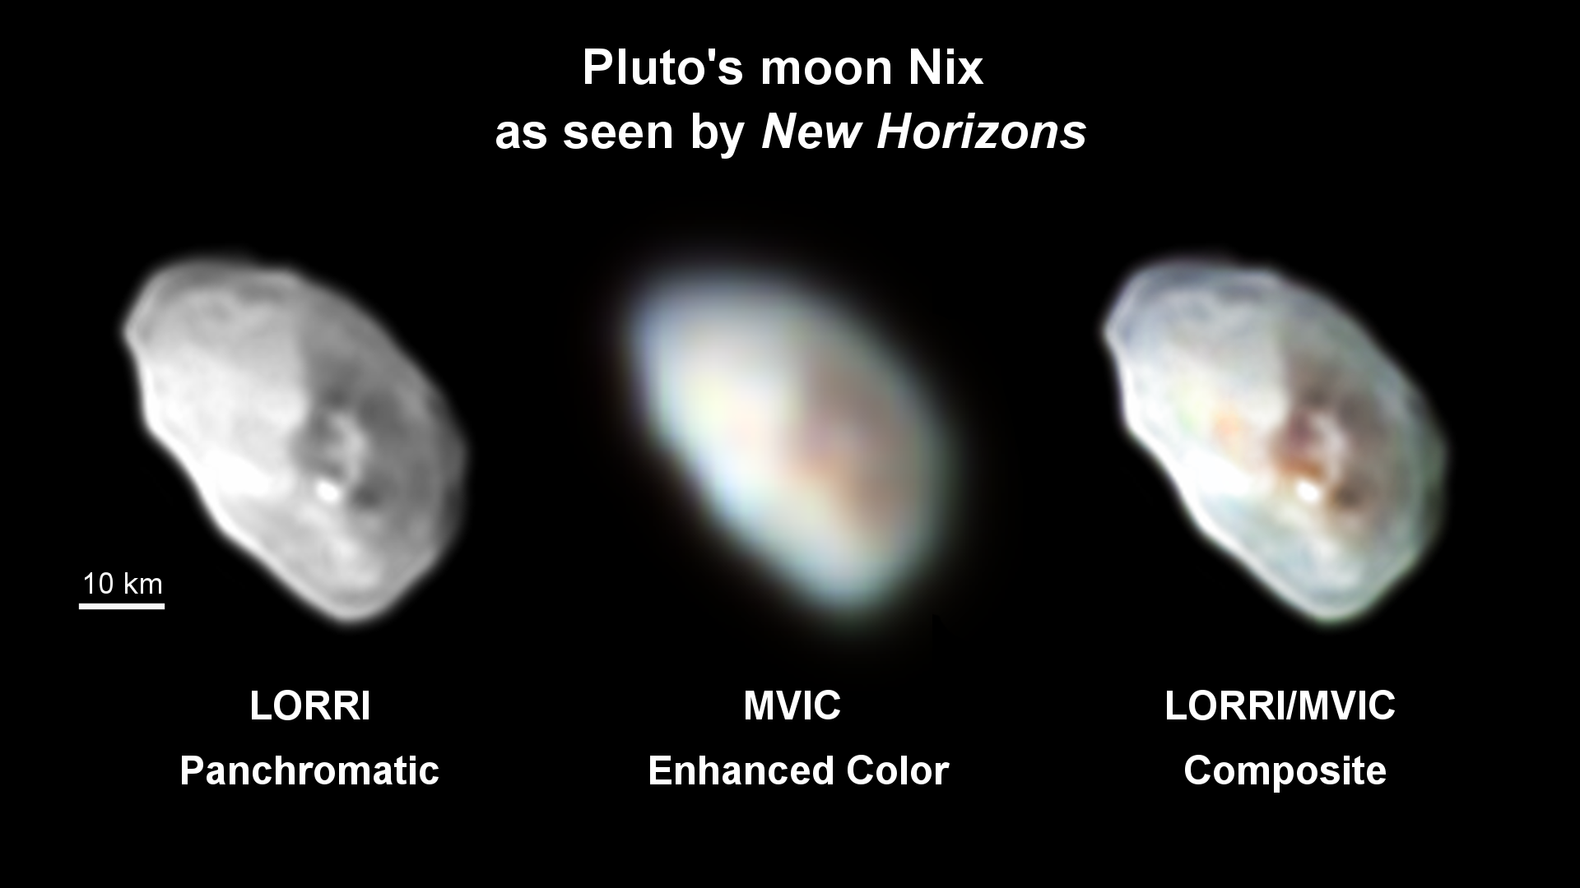

Slide 17
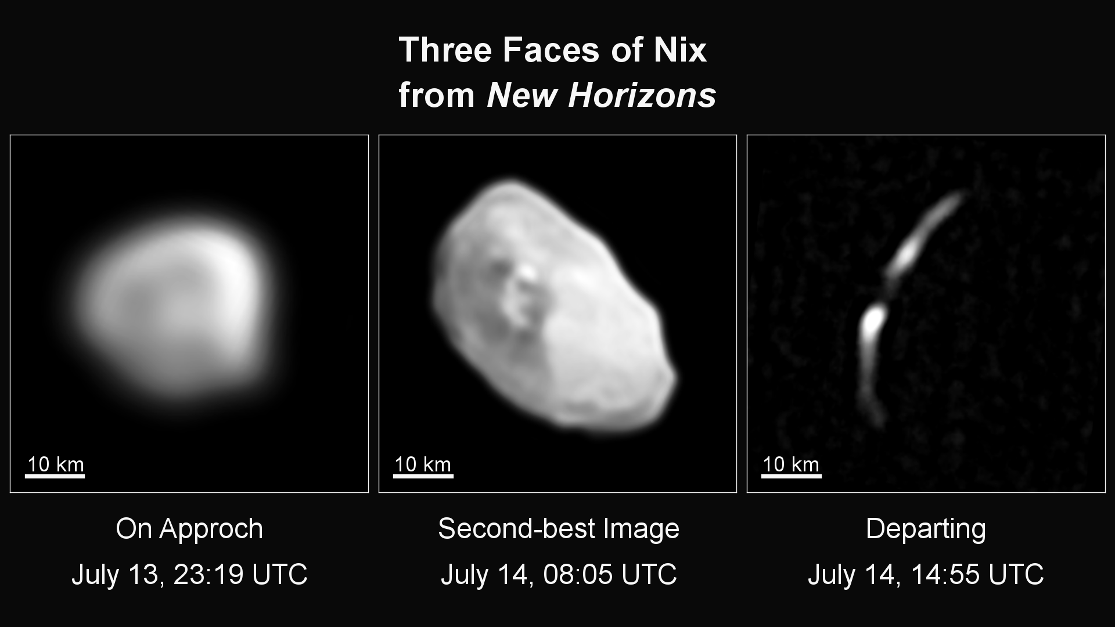

Slide 18
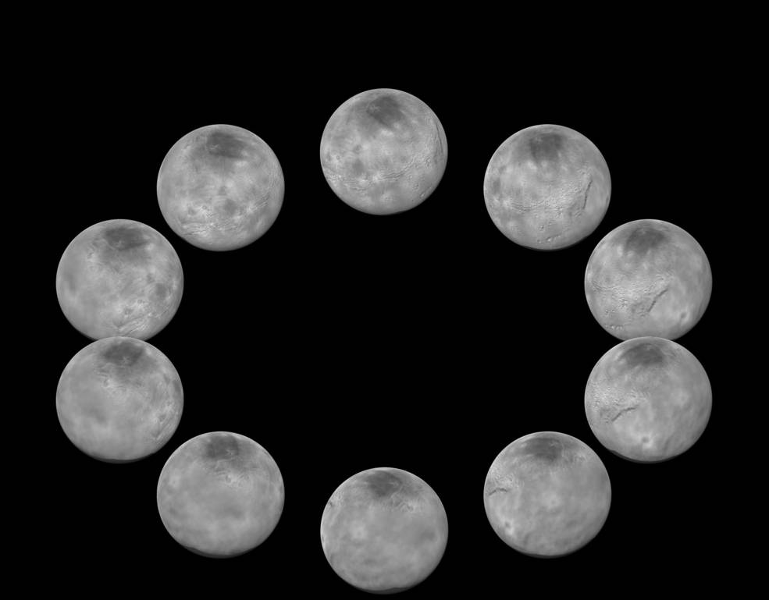
A Day on Charon

Slide 19
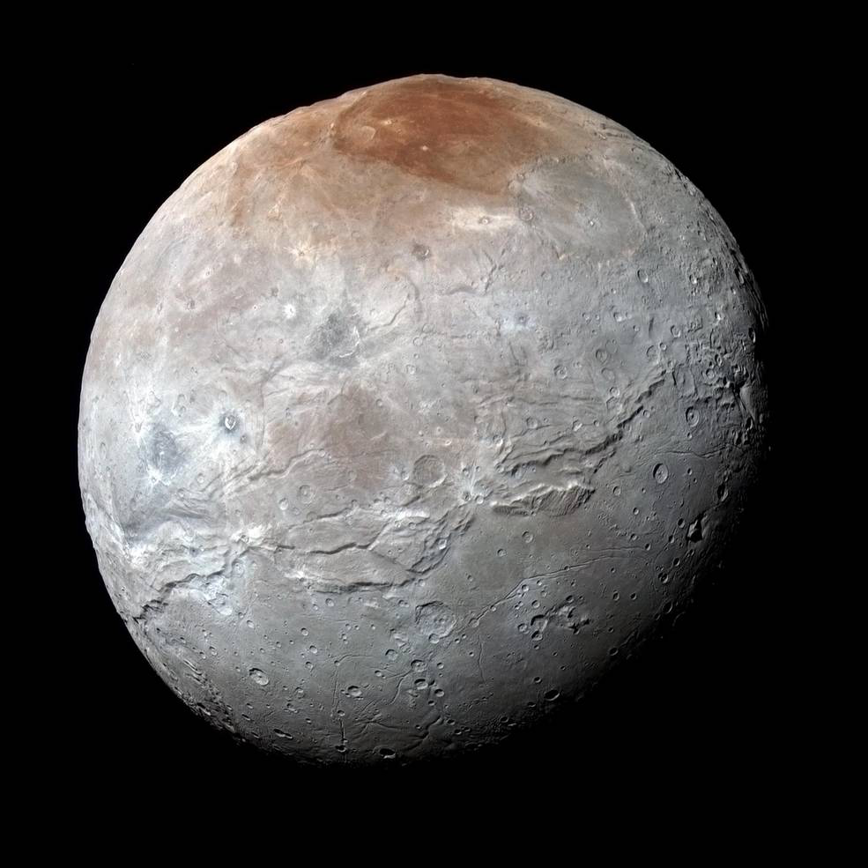
Charon in
Enhanced
Color

Slide 20
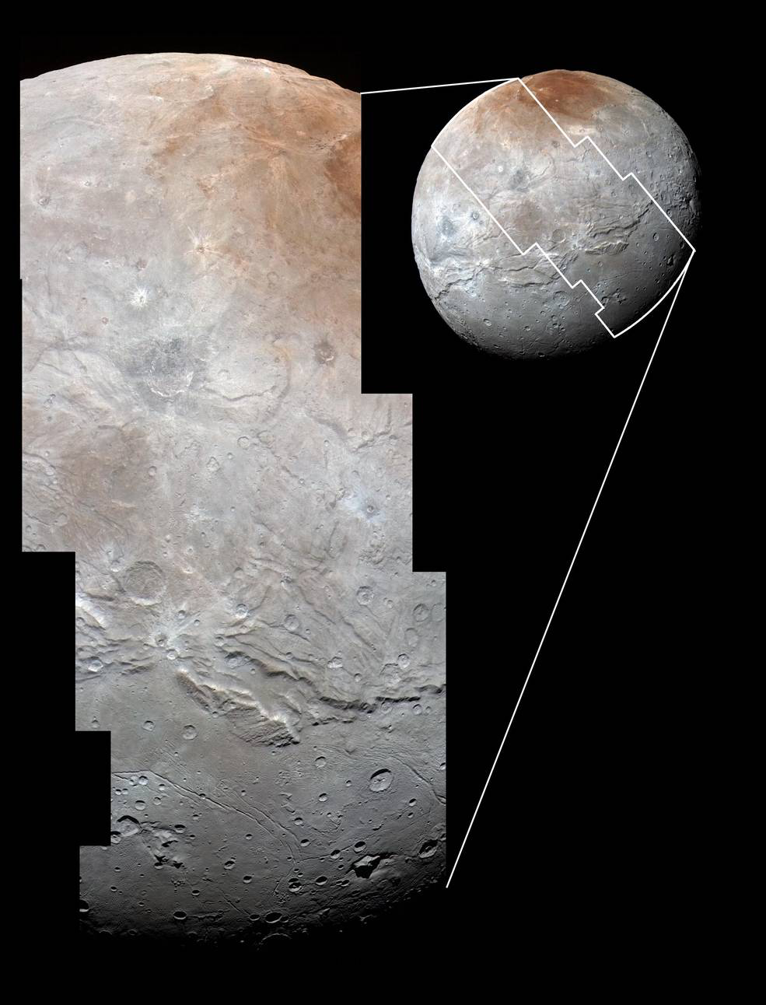
Charon Detail

Slide 21
Charon Detail

Slide 22
Beyer et al. 2016
Tectonics of Charon
LPSC, March 28, 2016
•Extension dominates Charon
•~1% expansion (~35 km shell thickening)

Slide 23
Plasma Predictions
Ionization of escaping atmosphere
Weak solar wind -> Large interaction region
Weak solar magnetic field -> kinetic rather than fluid
Bagenal & McNutt 1989; Kecskemety & Cravens 1993; Bagenal et al. 1997; Sauer 1997; Shevchenko et al. 1997; Ip et al. 2000; Delamere & Bagenal 2004; Harnett et al. 2005; Delamere 2009; Cravens & Strobel 2014; Bagenal et al. 2015

Slide 24
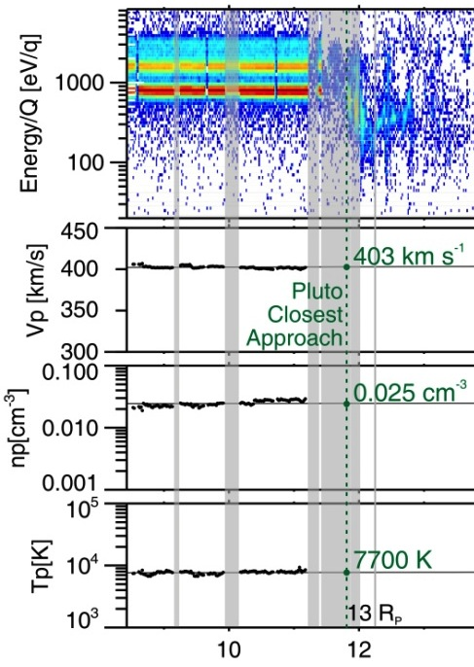
SWAP Results
Bagenal et al. 2016. Pluto’s interaction with its space environment. Science 351, aad9045
Upstream solar wind
A: <1%
slowing
A
B
B: 20%
slowing

Slide 25
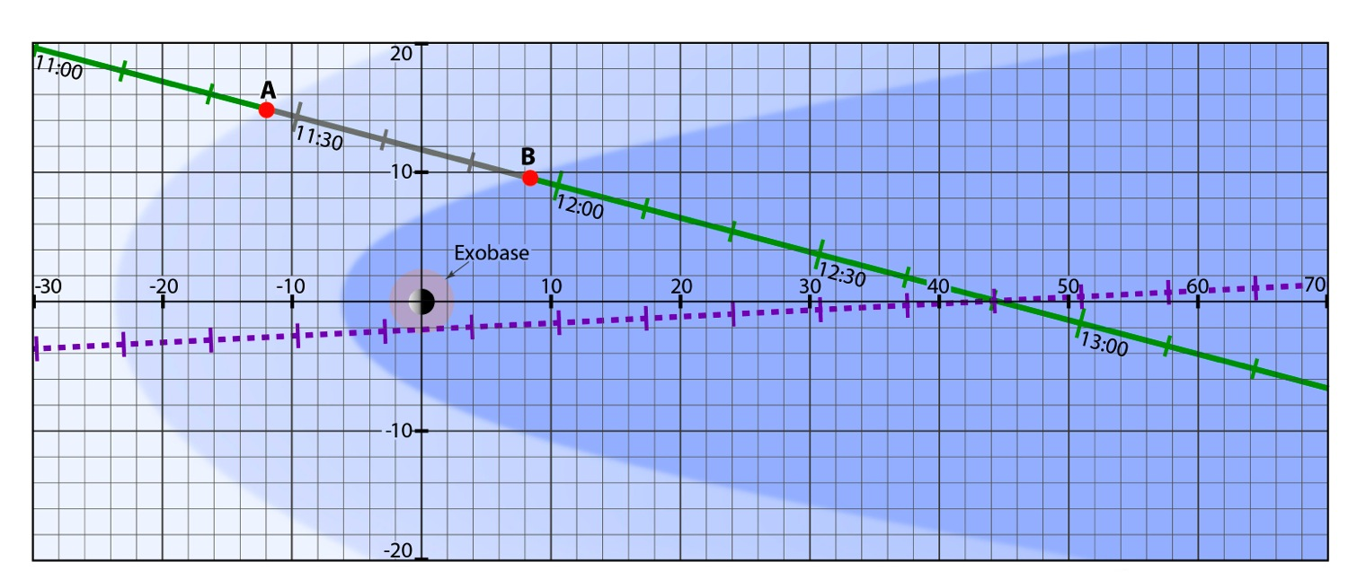
Interaction Geometry
Bagenal et al. 2016. Pluto’s interaction with its space environment. Science 351, aad9045
A: < 1% slowing of solar wind
SWAP & PEPSSI pointed away from solar wind
Y-axis
B: 20% slowing of solar wind
Shape for Mach ~40 shock
Z-axis
X-axis way from Sun

Slide 26
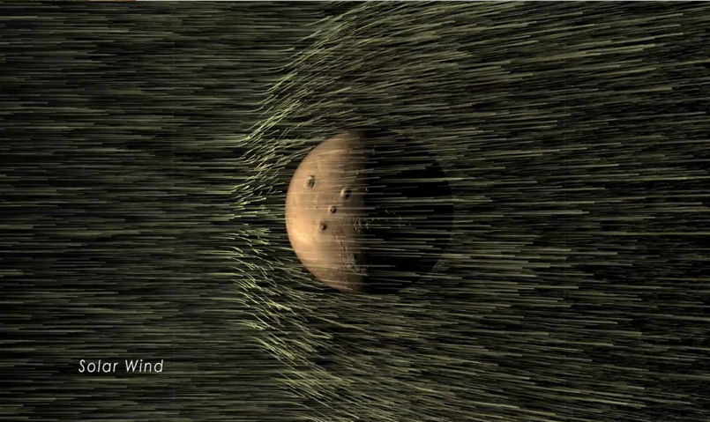
Pluto & Mars
Bagenal et al. 2016. Pluto’s interaction with its space environment. Science 351, aad9045
MAVEN at Mars:
Solar wind interaction with ionosphere
~10²⁵ molecules s⁻¹
Mars
New Horizons at Pluto:
500 weaker solar wind
Solar wind interaction with ionosphere or
~6 x 10²⁵ molecules s⁻¹
Weaker gravity -> extended atmosphere
Pluto
Exobase
Notes:
* This implies (we think) that this is MARS/VENUS LIKE -- small escape, solar wind deflected by electrical currents in the gravitationally bound ionosphere.
* Not COMET LIKE -- high escape, ionization of atmospheric material mass-loads the solar wind, causing slowing of the overall bulk flow of the solar wind

Slide 27
Pluto's Neutral Atmosphere
Gladstone et al. 2016 The atmosphere of Pluto as observed by New Horizons. Science 351, aad8866
Summers et al. 2016, LPSC, March 28, 2016

Slide 28
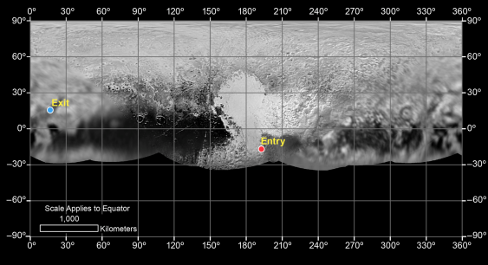
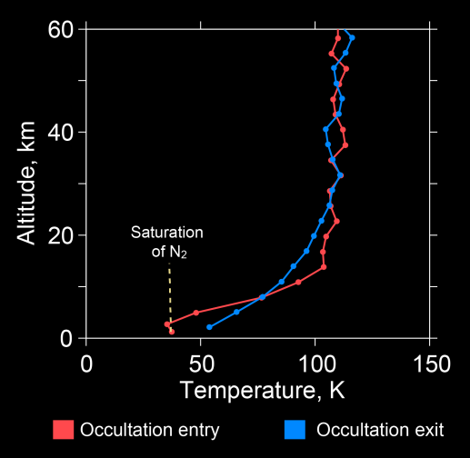
Pluto’s Lower Atmosphere
Altitude, km
Different temperatures at entry and exit occultations
N₂ sat
Entry:
DSS14 & 43
Notes:
REX radio occultation results show that Pluto’s near-surface atmosphere can be very different, depending on location. Previous models indicated a more globally uniform atmosphere.

Slide 29
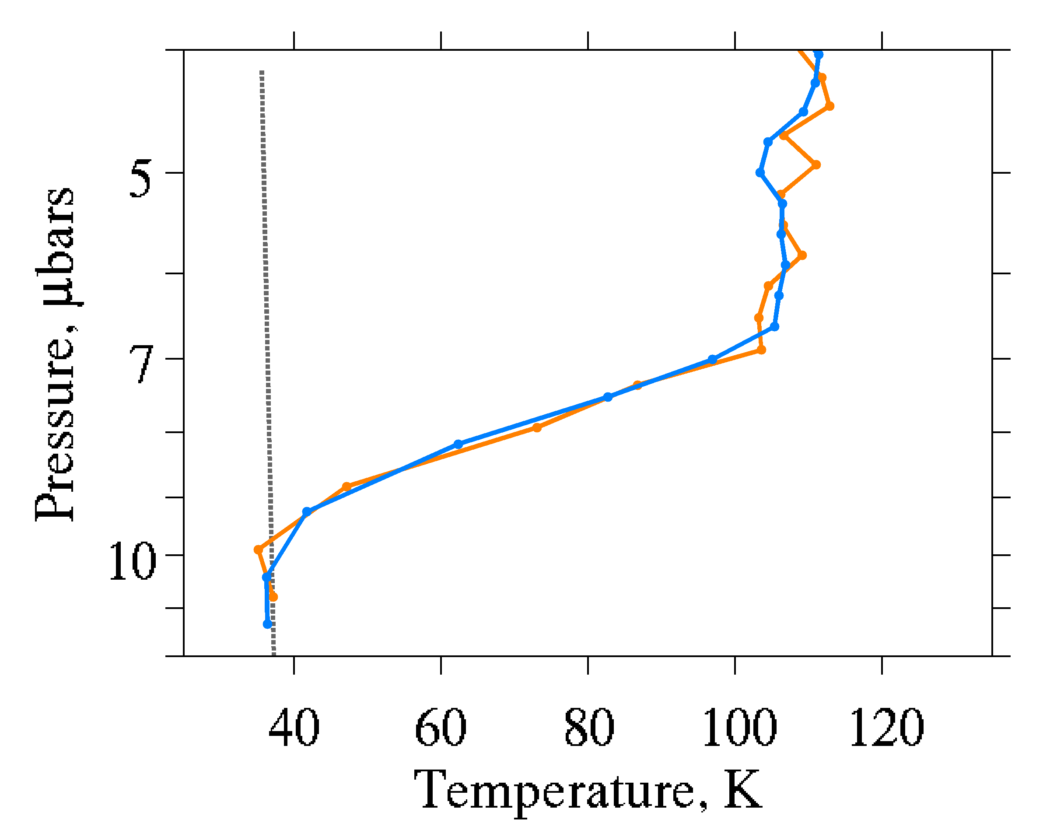
Pluto’s Lower Atmosphere
Altitude, km
Different temperatures at entry and exit occultations
N₂ sat
Entry:
DSS14 & 43
Notes:
REX radio occultation results show that Pluto’s near-surface atmosphere can be very different, depending on location. Previous models indicated a more globally uniform atmosphere.

Slide 30
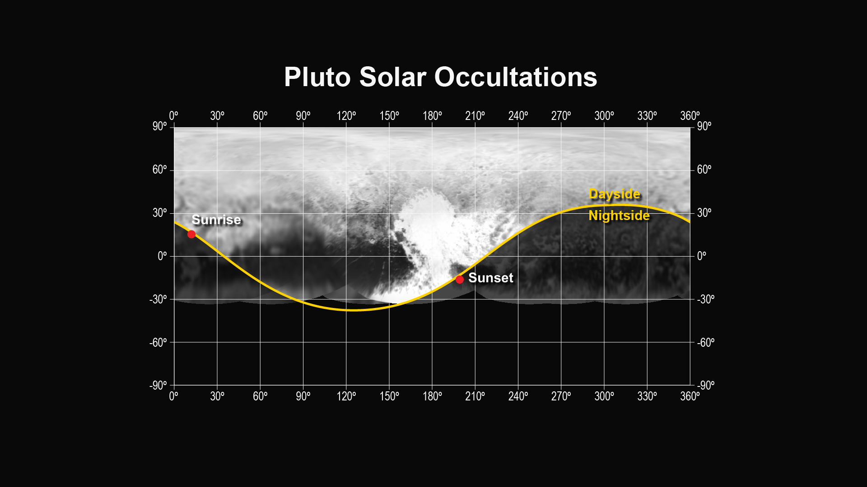
Locations probed by Radio and Solar occultations

Slide 31
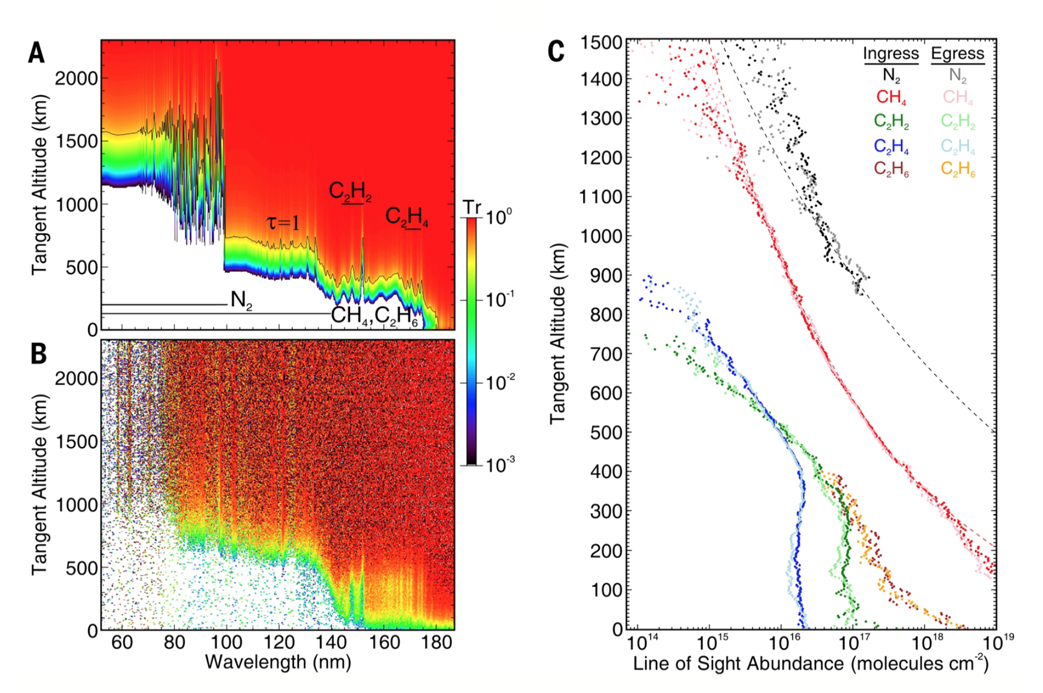

Slide 32
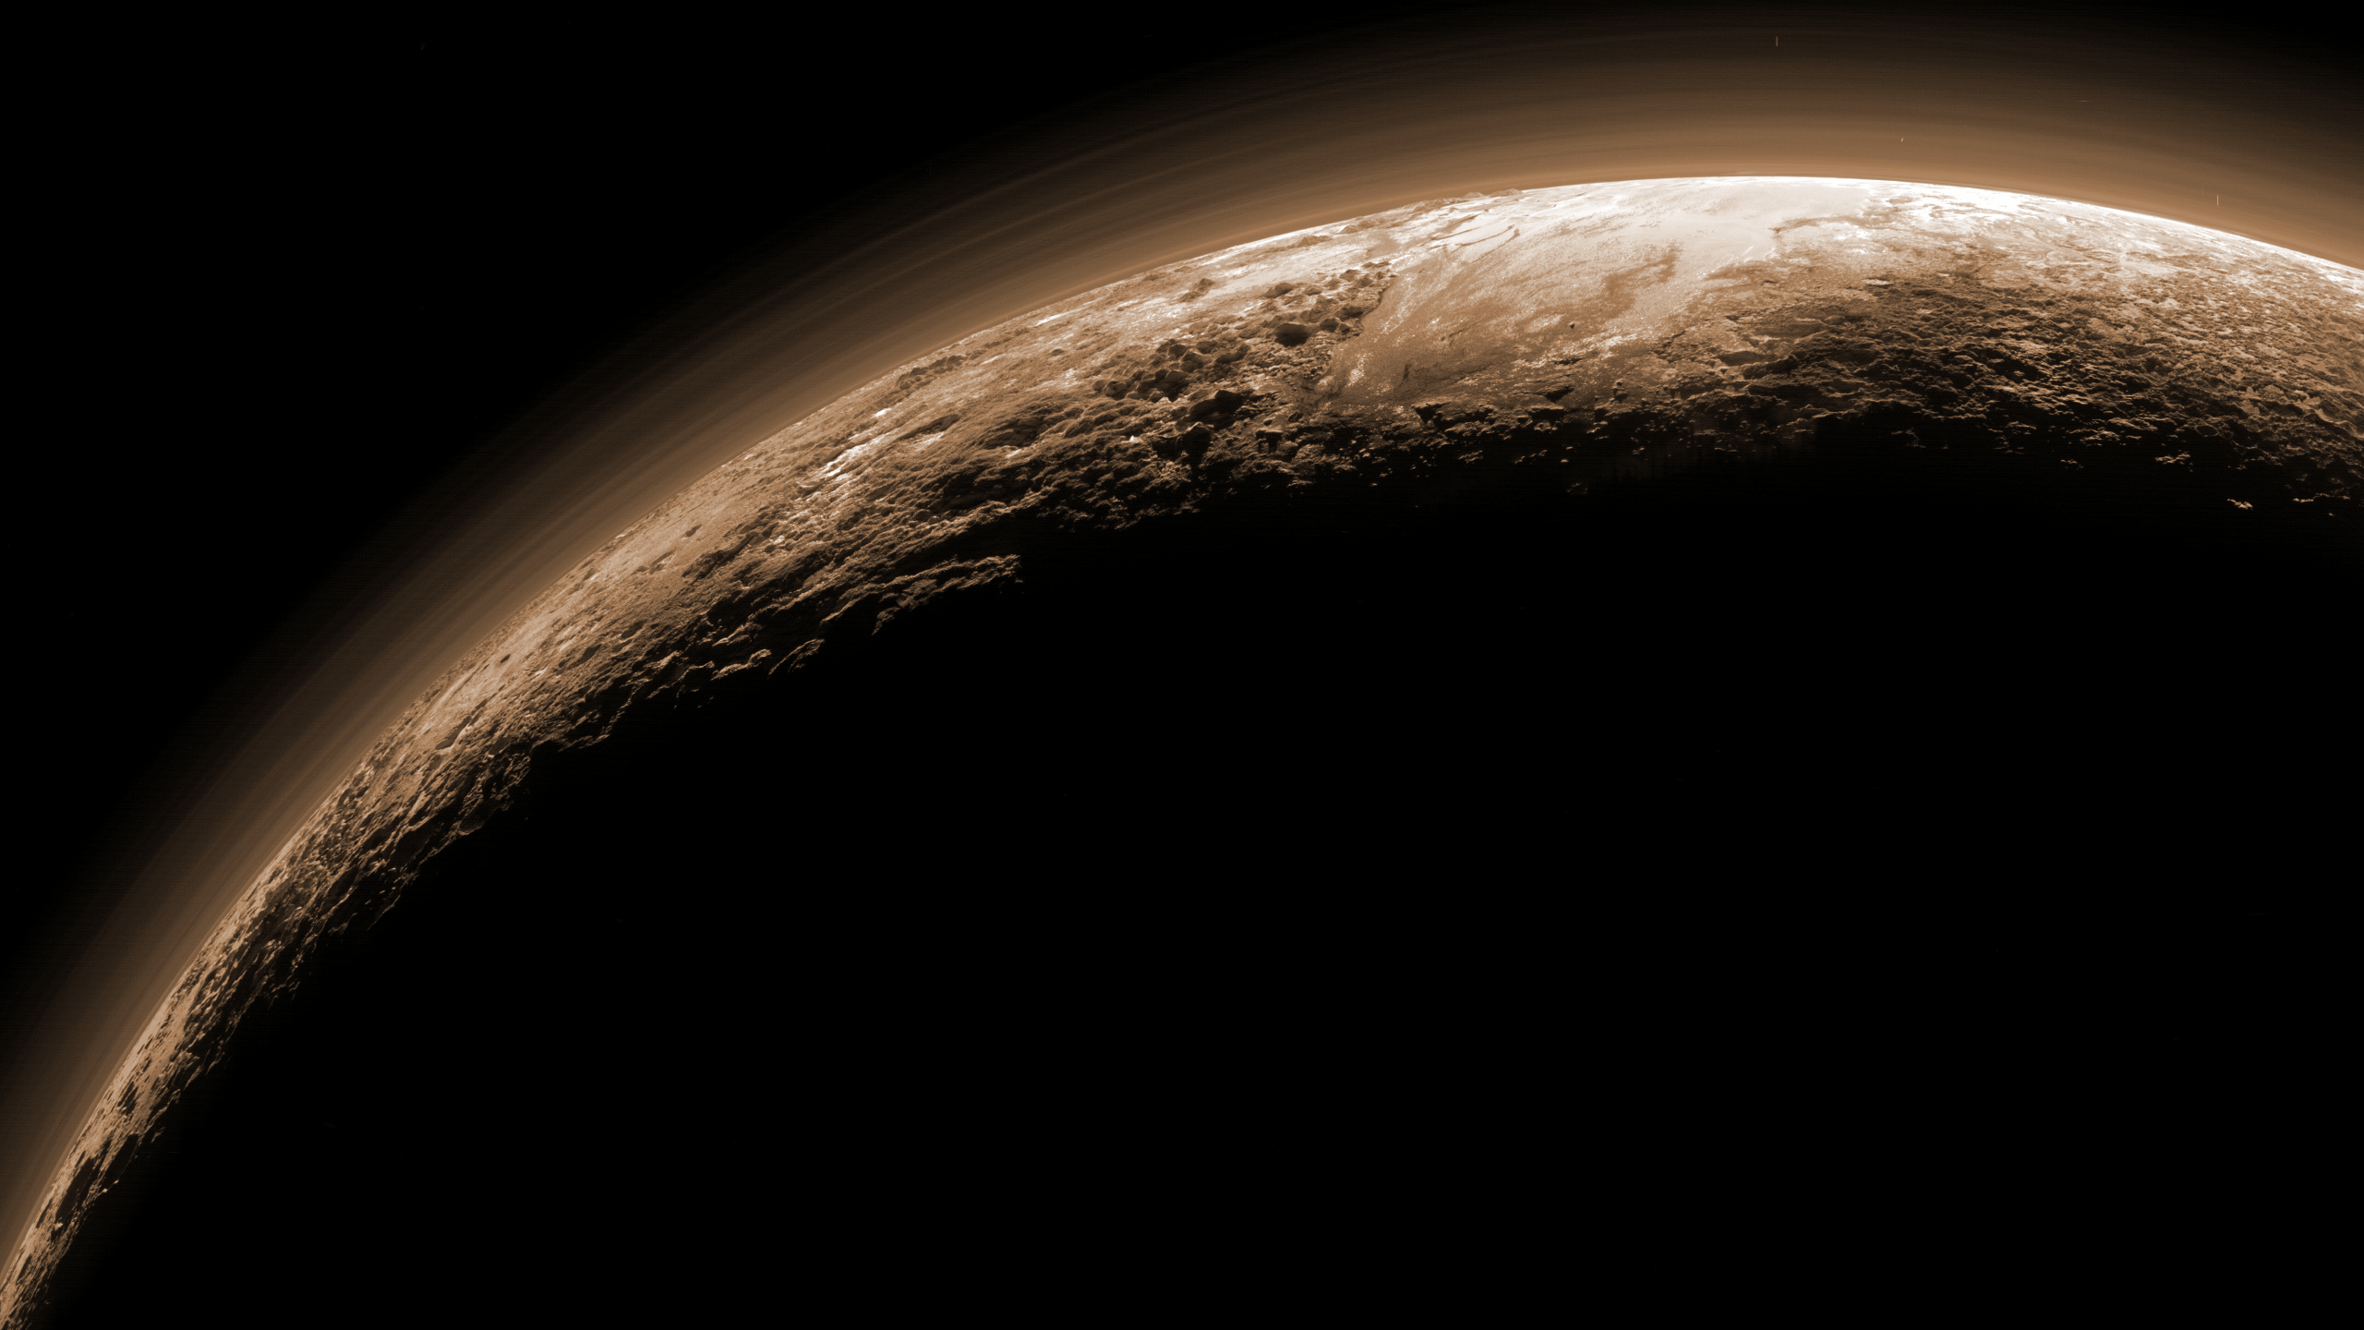
Pluto Haze Layers
HAZE
→Haze present to over 200 km altitude, everywhere.
→Average Scale Height ~45-55 km.
→As many as 20 embedded individual thin (~1-4 km) layers.
→Layers coherent over large horizontal distances
(~1000 km).
→Haze in high temperature part of the atmosphere where single phase condensation is impossible.
Notes:
One of the most significant discoveries of the New Horizons mission was that the atmosphere has a complex layered structure, with
as many as 20 layers extending up to as much as 200 km above the surface. A thin haze layer was expected due to the condensation
of photochemically produced hydrocarbons, but nothing was predected as complex as that observed.

Slide 33
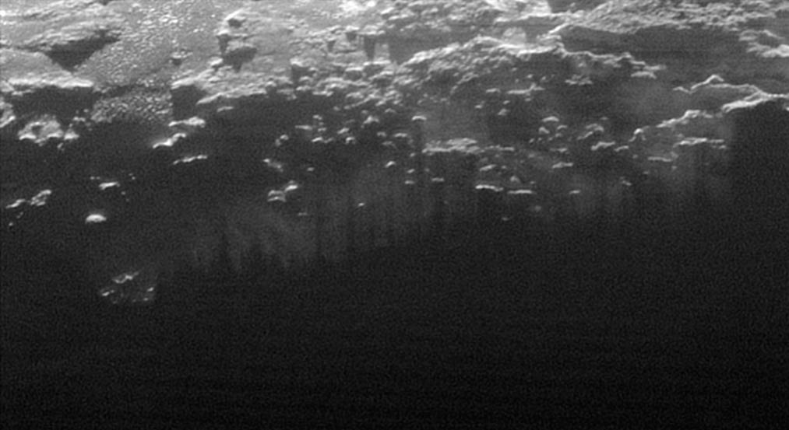
Crepuscular Rays

Slide 34

Crepuscular Rays
Earth
Pluto

Slide 35
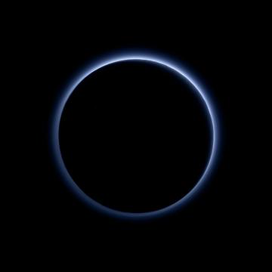
Pluto's Blue Sky

Slide 36
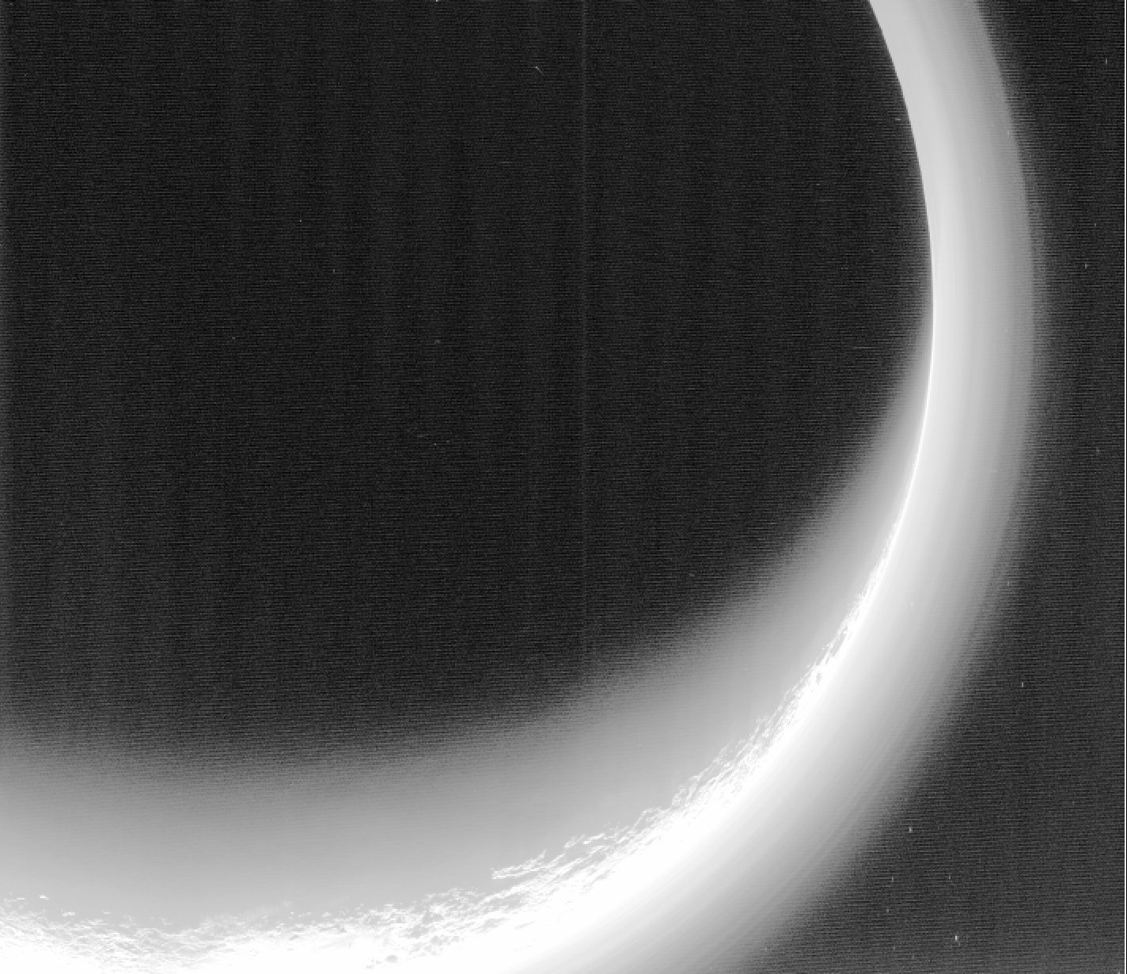

Titan
Pluto

Slide 37
Pluto's Surface Color & Composition

Slide 38
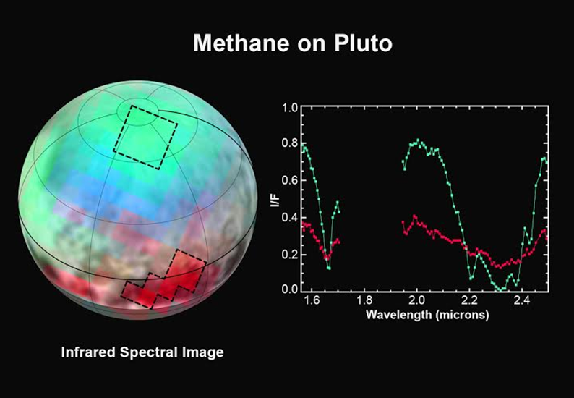
Notes:
Spring/summer 2015

Slide 39

Spectra in
Times Square!
Notes:
Spring/summer 2015

Slide 40
Schmitt et al. 2016, LPSC, March 28, 2016

Slide 41
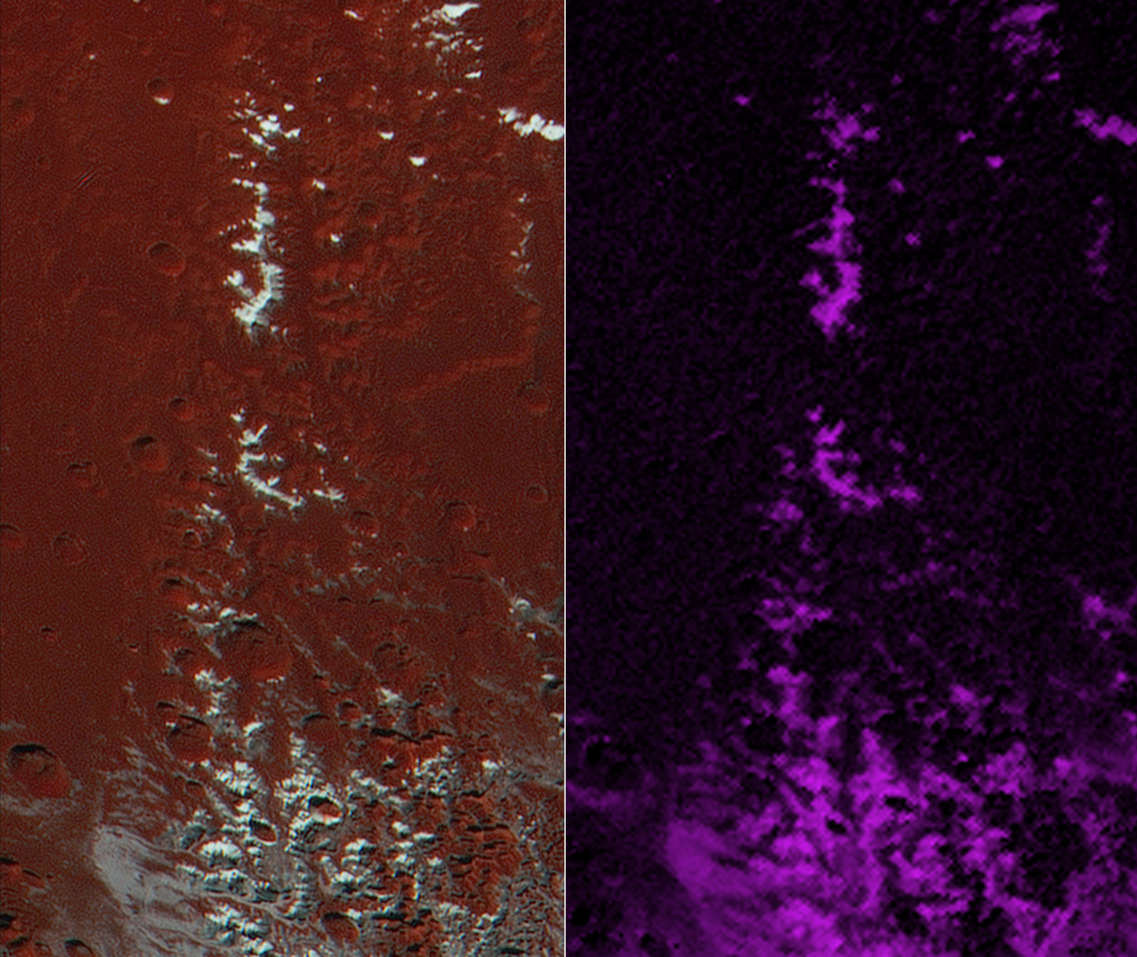
Topographic Effects
Extended color
CH₄ ice
Notes:
Altitude and topography/orientation

Slide 42
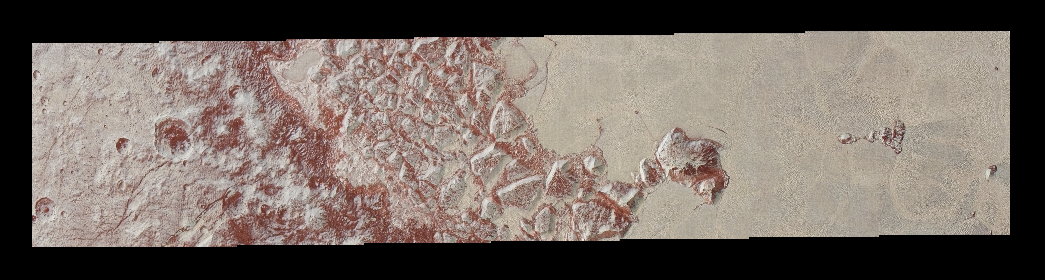
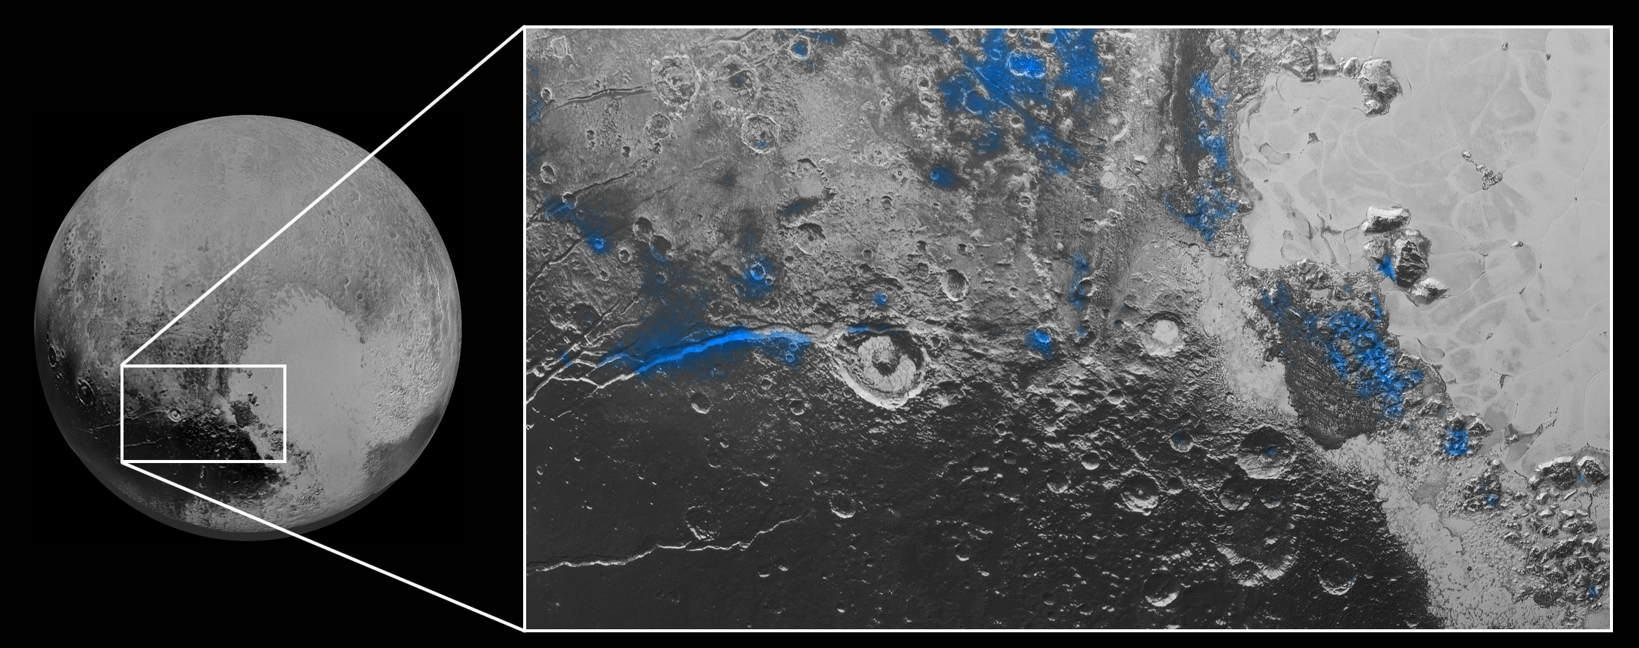
Enhanced Color
H₂O Ice

Slide 43
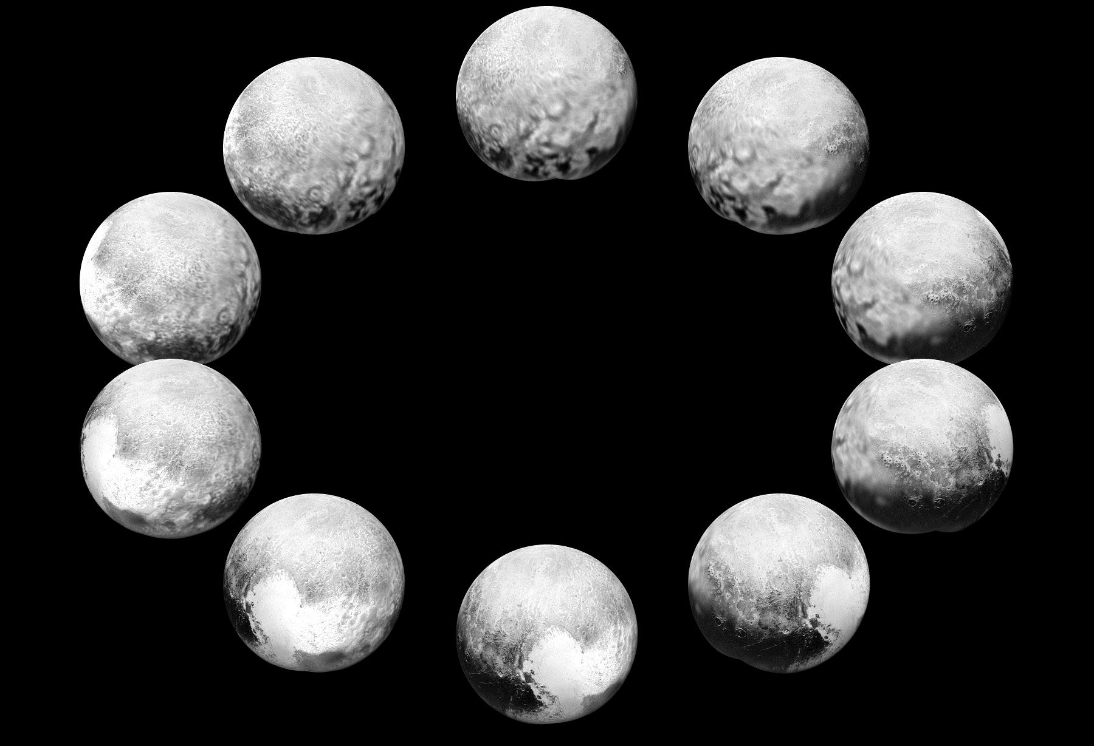
A Day on Pluto

Slide 44
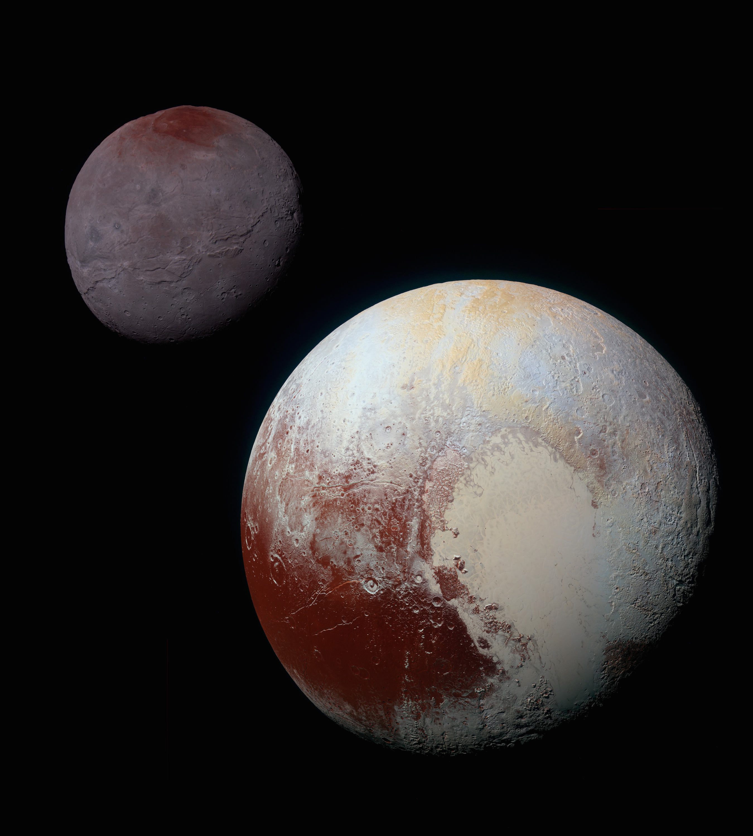
Enhanced Color
Charon
Pluto

Slide 45
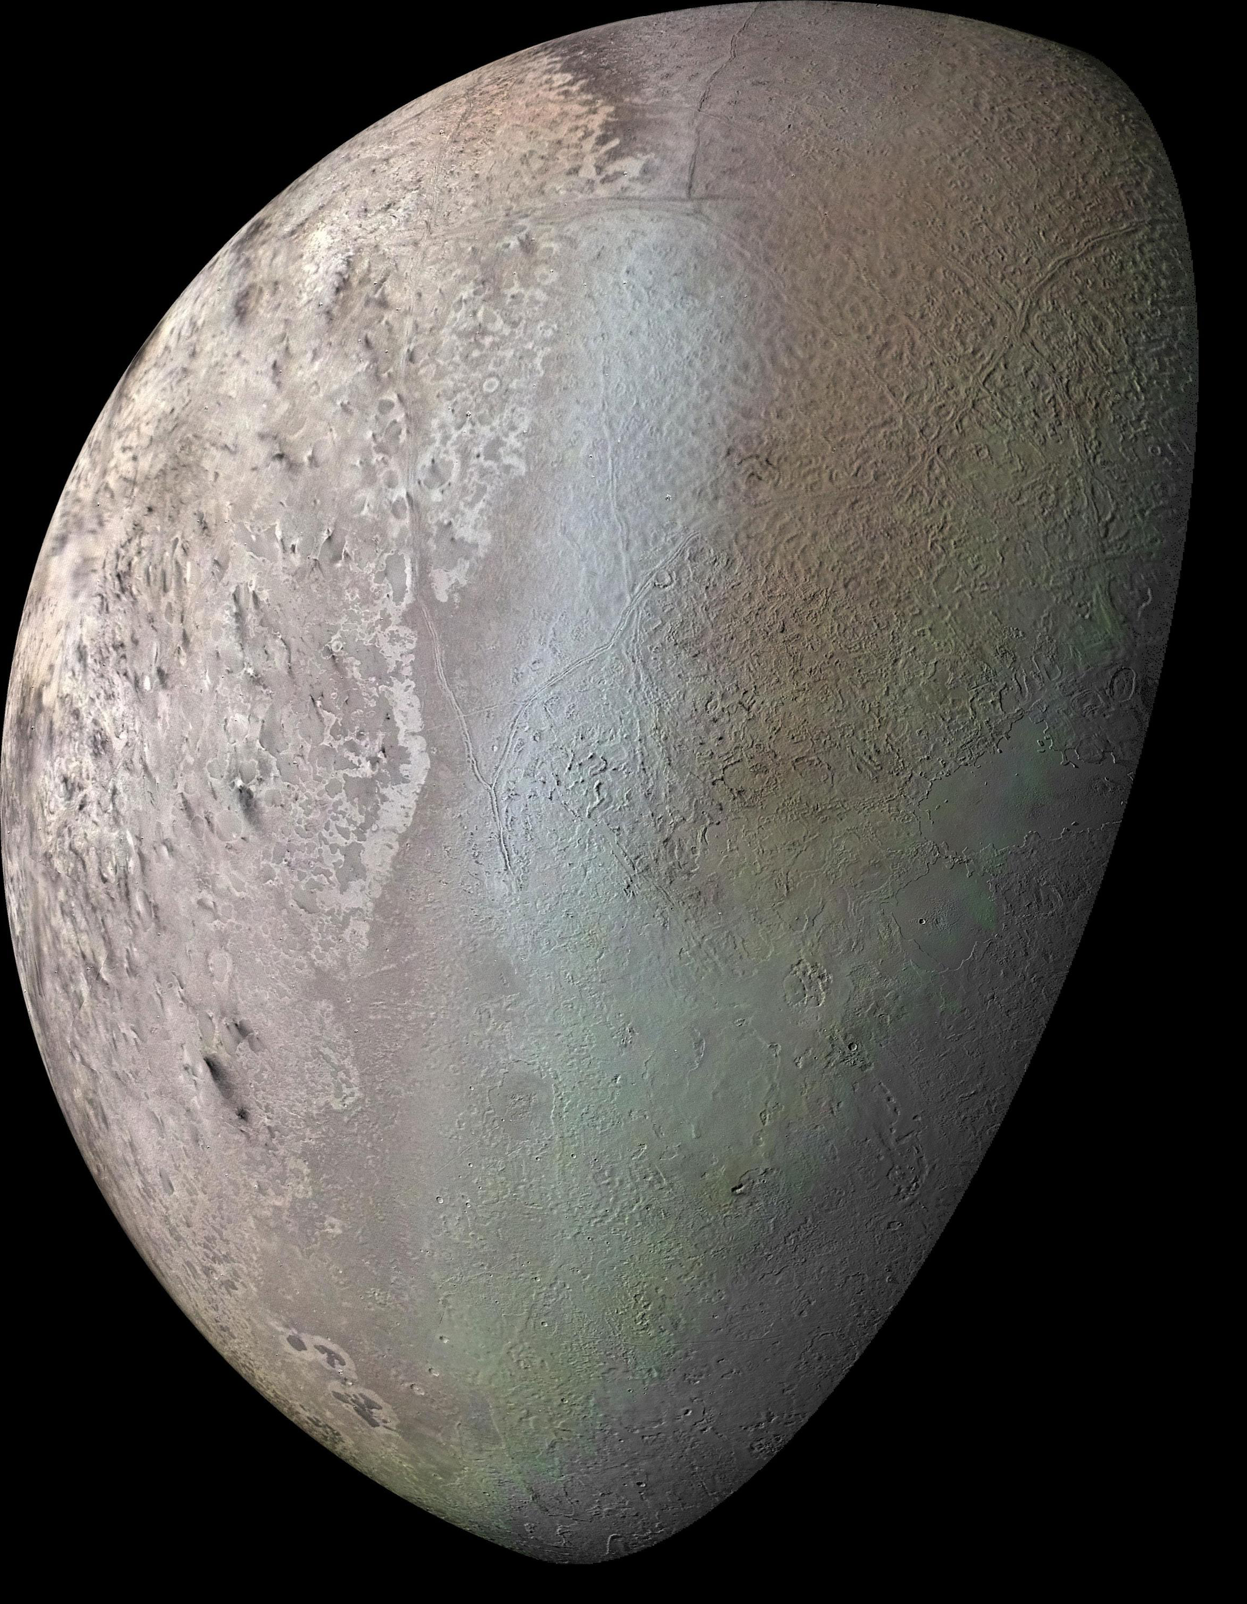
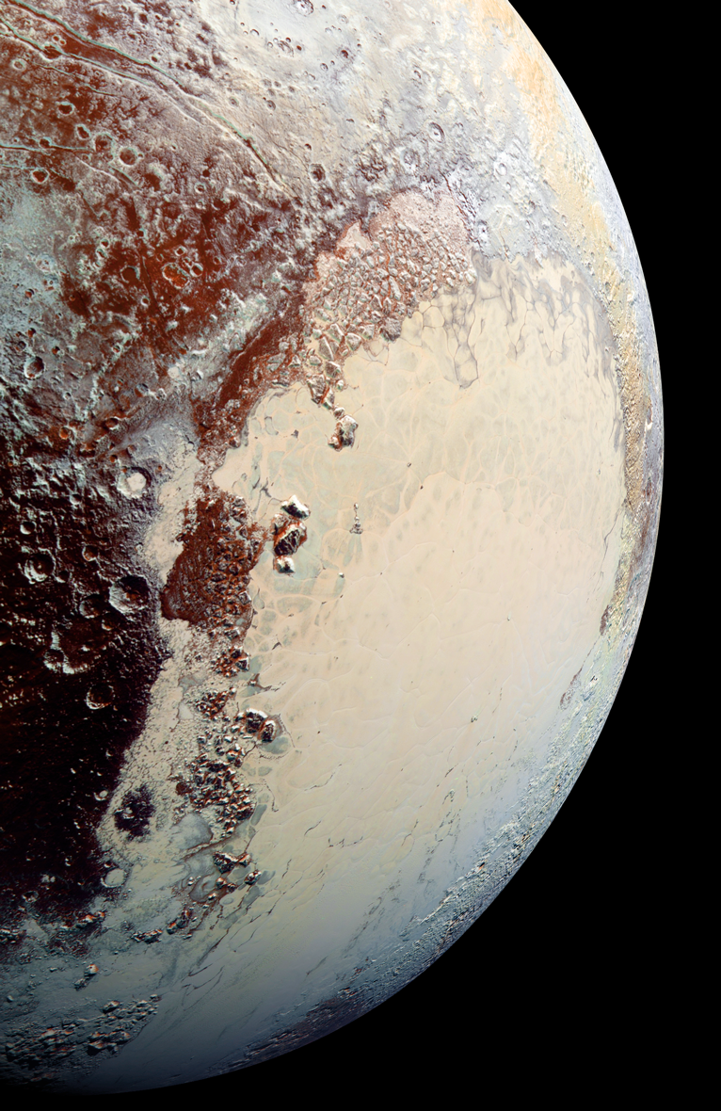
Triton
Pluto

Slide 46
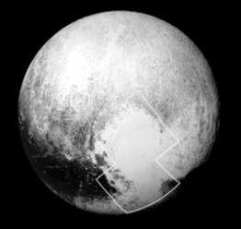
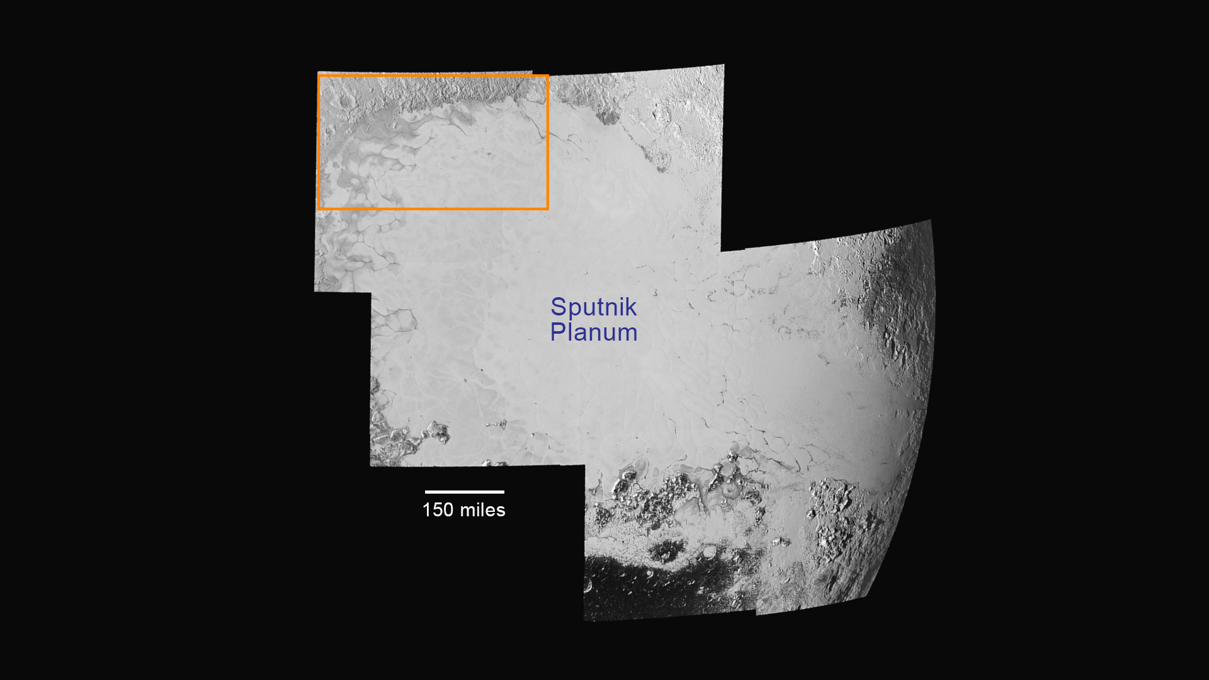
Glacial Flow on Pluto
Notes:
P_LORRI_STEREO_MOSAIC: Jul 14, 2015, 10:10 UTC, 0.38 km/pix, Pluto Long: 158.3.
Seven of 15 from a mosaic were downloaded

Slide 47
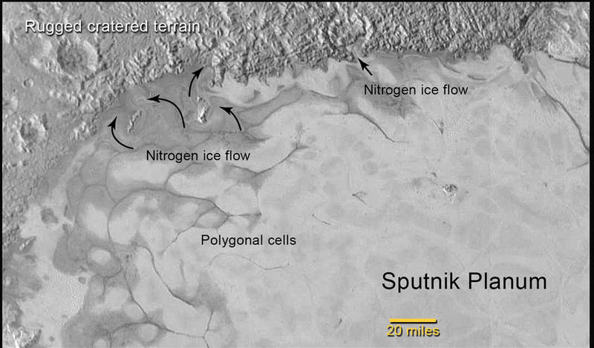
Notes:
Scale bar: 20 miles = 32 km
In the northern region of Pluto’s Sputnik Planum, swirl-shaped patterns of light and dark suggest that a surface layer of exotic ices has flowed around obstacles and into depressions, much like glaciers on Earth.
P_LORRI_STEREO_MOSAIC: Jul 14, 2015, 10:10 UTC, 0.38 km/pix, Pluto Long: 158.3.
The close-up image was taken about 1.5 hours before New Horizons closest approach to Pluto, when the craft was 47,800 miles (77,000 kilometers) from the surface of the planet. The image easily resolves structures smaller than a mile across.

Slide 48
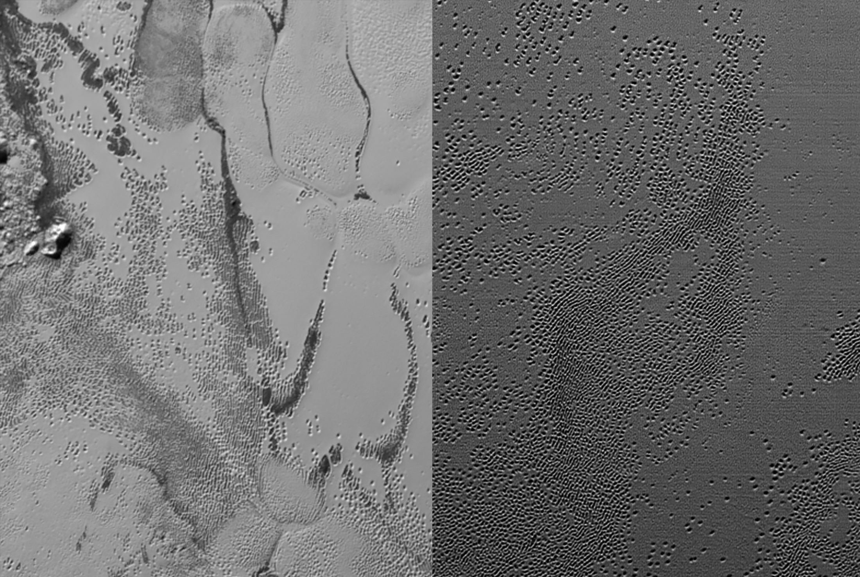
Pluto's Pits

Slide 49
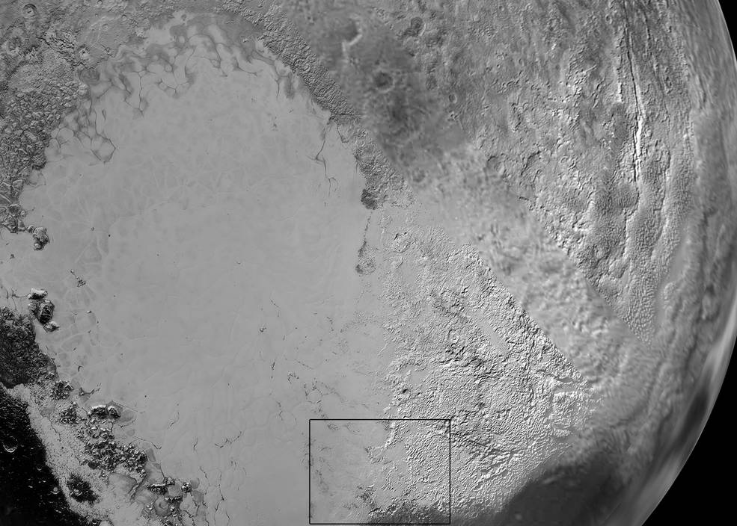

Slide 50
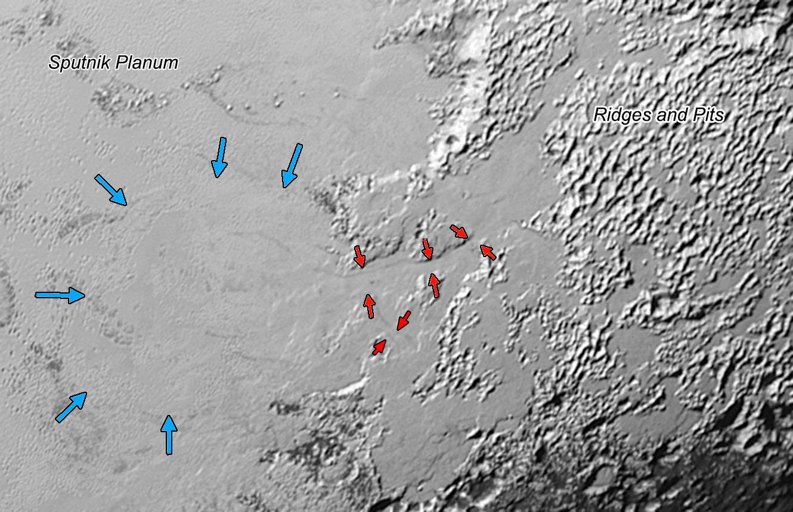
Flow at Low Phase

Slide 51
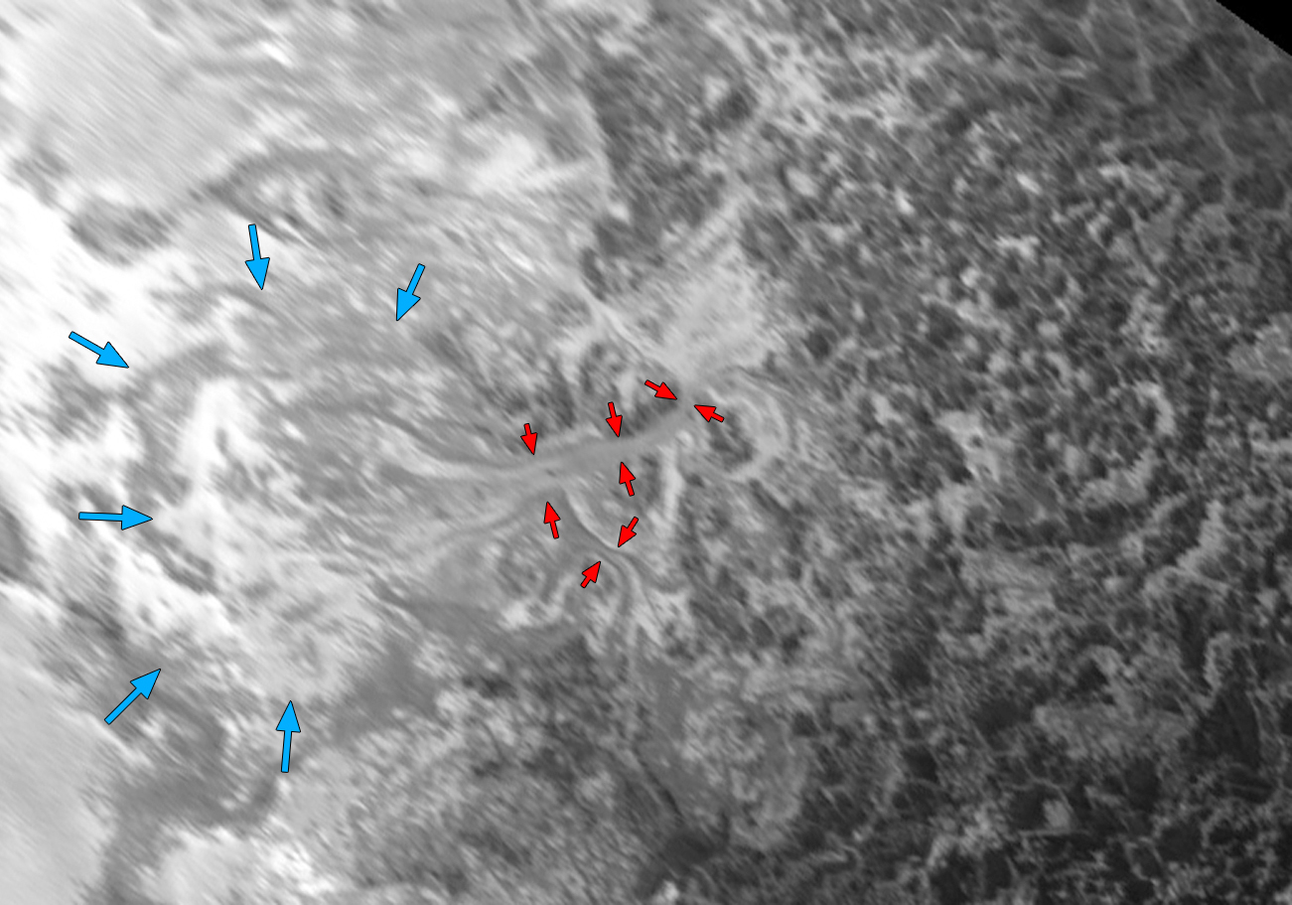
Flow at High Phase

Slide 52

Mountains on
Pluto
Notes:
Spring/summer 2015

Slide 53
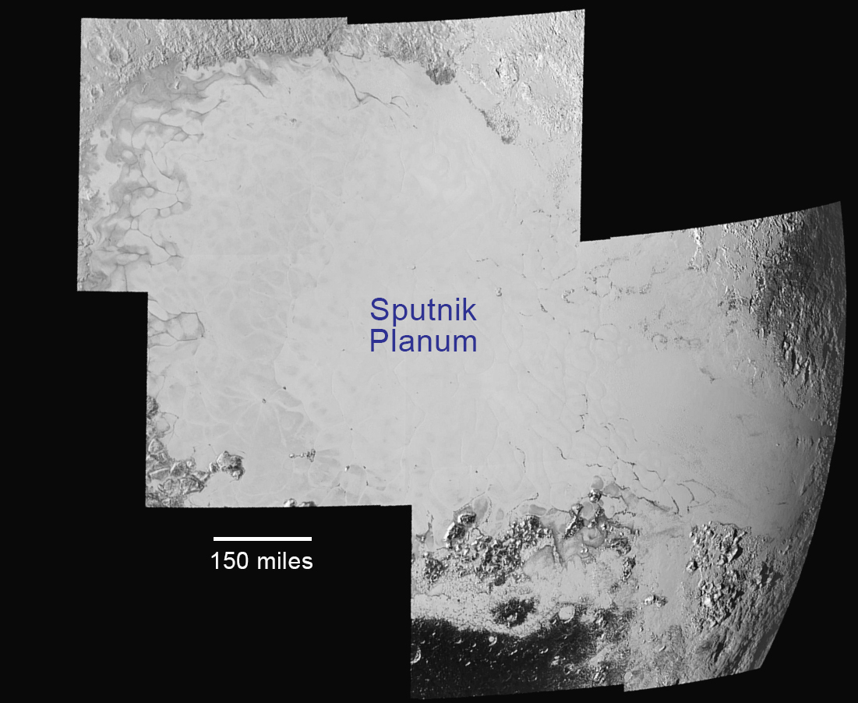
Notes:
Spring/summer 2015

Slide 54
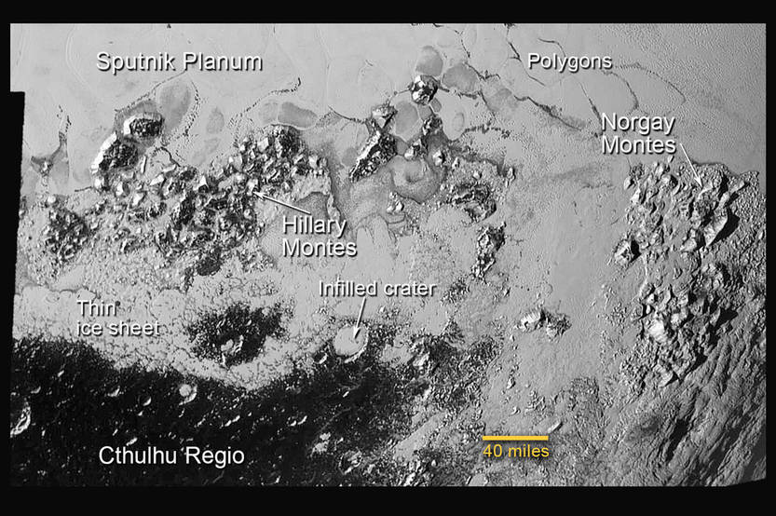
Notes:
Scale bar: 40 miles = 64 km
This annotated image of the southern region of Sputnik Planum illustrates its complexity, including the polygonal shapes of Pluto’s icy plains, its two mountain ranges, and a region where it appears that ancient, heavily-cratered terrain has been invaded by much newer icy deposits.
The large crater highlighted in the image is about 30 miles (50 kilometers) wide, approximately the size of the greater Washington, DC area.
Many of the craters appear to be significantly degraded or infilled, and some are highlighted by bright ice-rich deposits on their rims and/or floors
Cthulhu Regio (CR) is also observed to be densely cratered.
A number of tectonic features have been identified, including scarps and troughs up to 600 km in length within and to the north of CR.

Slide 55
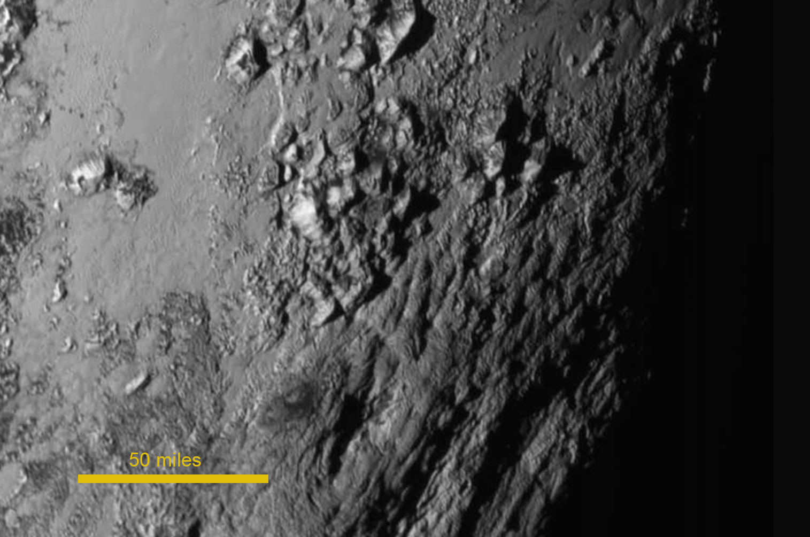
Notes:
Scale Bar: 50 miles = 80 km
New close-up images of a region near Pluto’s equator reveal a giant surprise: a range of youthful mountains (Norgay Montes) rising as high as 11,000 feet (3,500 meters) above the surface of the icy body. Heights similar to those Earth’s Rocky Mountains.
This close-up region, which covers less than one percent of Pluto’s surface, may still be geologically active today.
Youthful age estimate on the lack of craters in this scene. The existence of such high, steep-sided mountains and other steep terrains on Pluto requires construction from materials that will not relax under their own weight on geologic timescales, and therefore implies the presence of a widespread, water-ice-based “bedrock,” a significant discovery.
P_LORRI_STEREO_MOSAIC: Jul 14, 2015, 10:10 UTC, 0.38 km/pix, Pluto Long: 158.3.
The close-up image was taken about 1.5 hours before New Horizons closest approach to Pluto, when the craft was 47,800 miles (77,000 kilometers) from the surface of the planet. The image easily resolves structures smaller than a mile across.

Slide 56
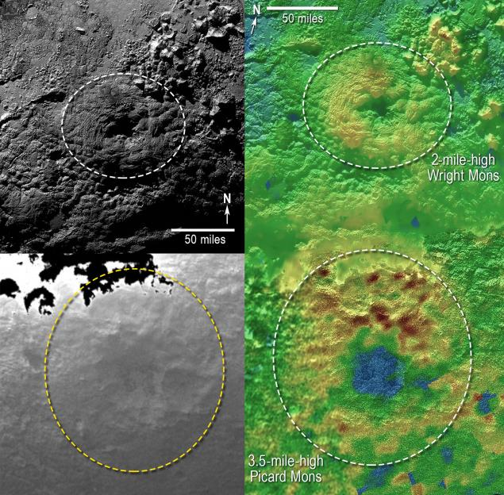
Volcanoes South of Sputnik Planum
Mountains a few miles high with summit craters; might be volcanoes
Notes:
Mountains a few miles high with summit craters might be volcanoes.

Slide 57
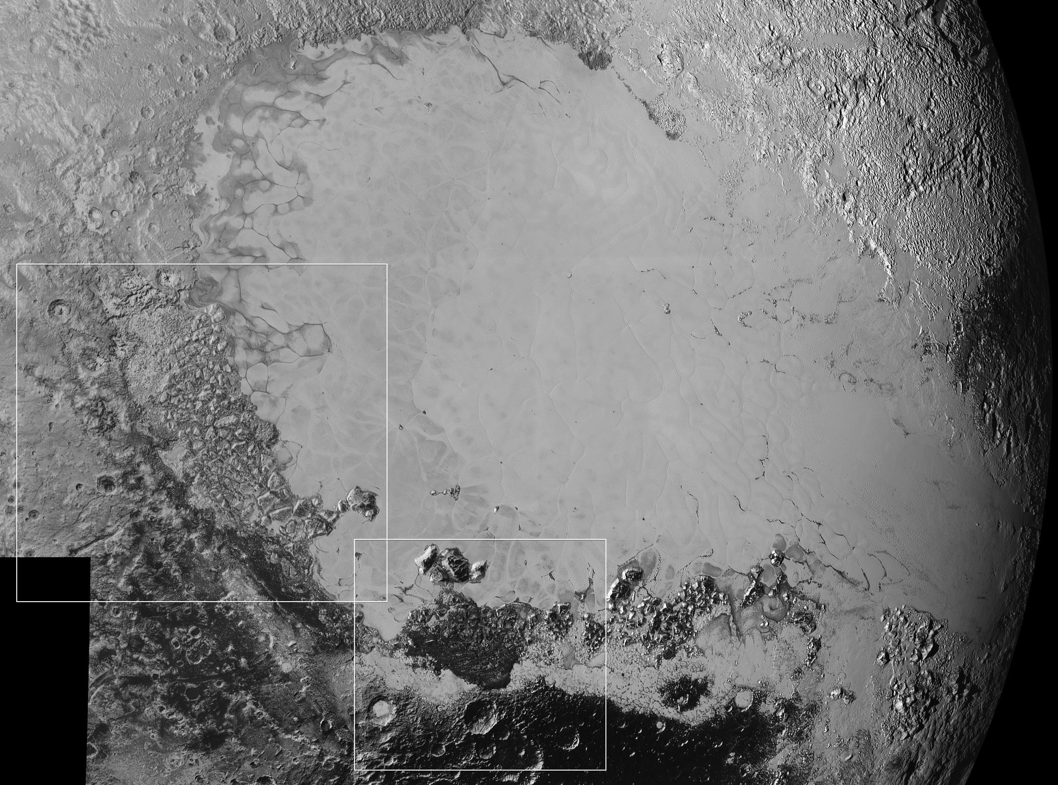

Slide 58
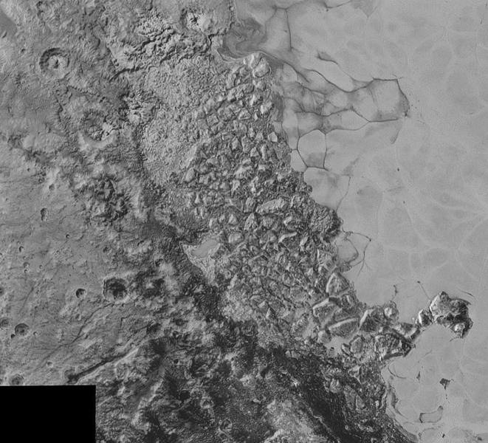

Slide 59
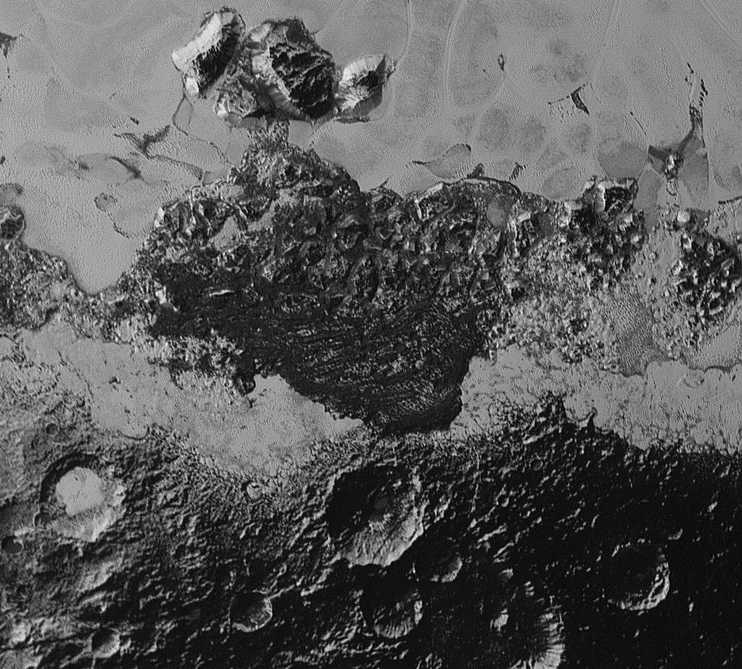

Slide 60
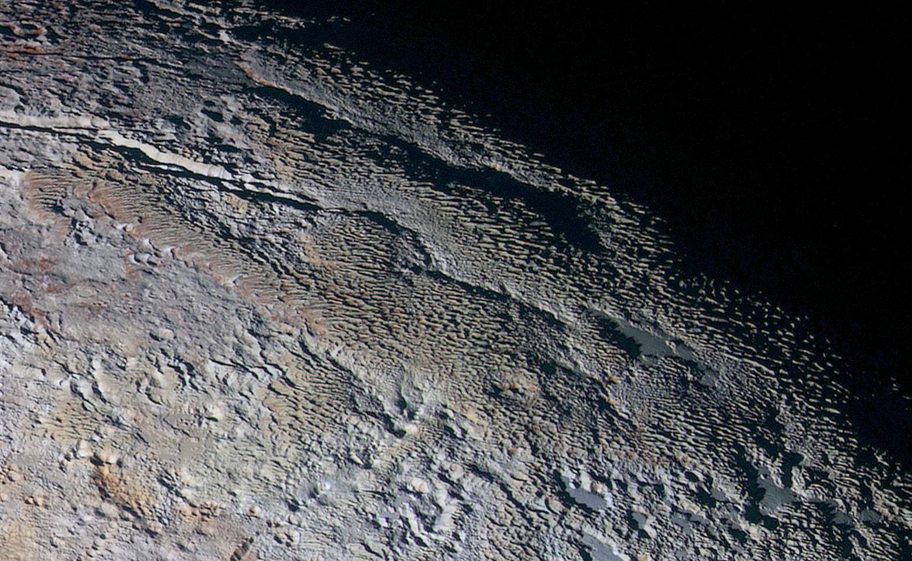
Notes:
Spring/summer 2015

Slide 61

Notes:
Spring/summer 2015

Slide 62


Slide 63

Potential Target 1 (PT1)
KBO 2014 MU69

Slide 64

New Horizons has completed
targeting maneuvers for 2014 MU69
for a January 1, 2019 arrival

Slide 65

Want more? layoung@boulder.swri.edu
https://www.nasa.gov & http://pluto.jhuapl.edu

Slide 66
A few for Chris, if he wants them

Slide 67

New Horizons Spacecraft & Instruments
2.1 meters
Radio Experiment
High-Resolution Imager
UV spectrometer
Particle Detector
Wide-field
Imager &
NIR Imaging
spectrometer
Solar Wind Detector
Dust
Counter
Notes:
67

Slide 68




Building New Horizons
2.1 meters
1.6 meters

Slide 69

January 19, 2006 14:00:00 EST

