Slide 1
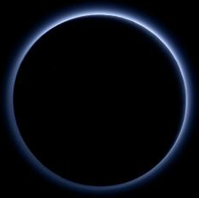
Pluto's Atmosphere
Leslie Young (Southwest Research Institute)
&
Randy Gladstone (SwRI)
Michael Summers (GMU)
Heather Elliot (SwRI)
David Hinson (Stanford)
Andrew Cheng (JHU/APL)
Alan Stern (SwRI)
Emmanuel Lellouch (Obs. Paris)
Bruno Sicardy (Obs. Paris)
Jeffrey Moore (NASA Ames)
Darrell Strobel (JHU/APL)
Yuk Yung (CalTech)
Tanguy Betrand (CNRS)
Francois Forget (CNRS) with thanks to the New Horizons Team
Notes:
Adapted from LAYoung_COSPAR2022_v7

Slide 2
Pluto's Atmosphere
Part 1: What we think we know
Occultations (Earth-based, Radio, UV)
ALMA
Haze imaging
Clues from geology

Slide 3
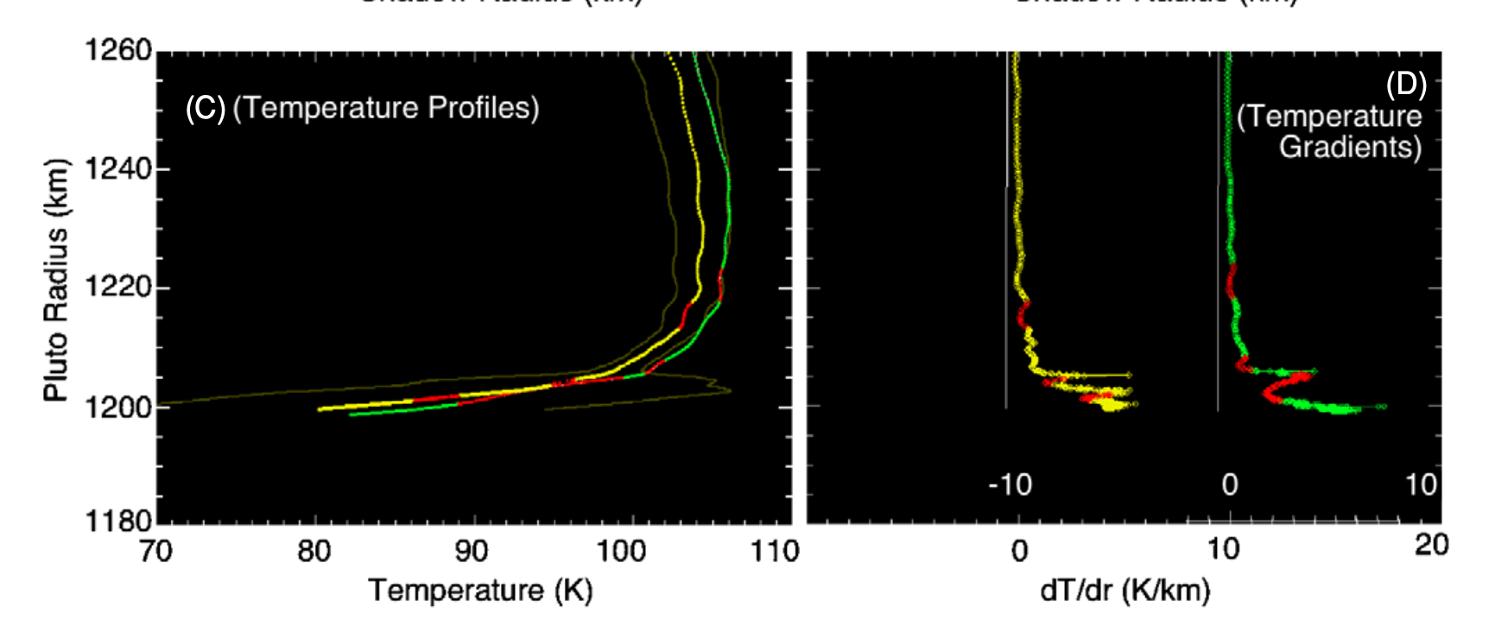
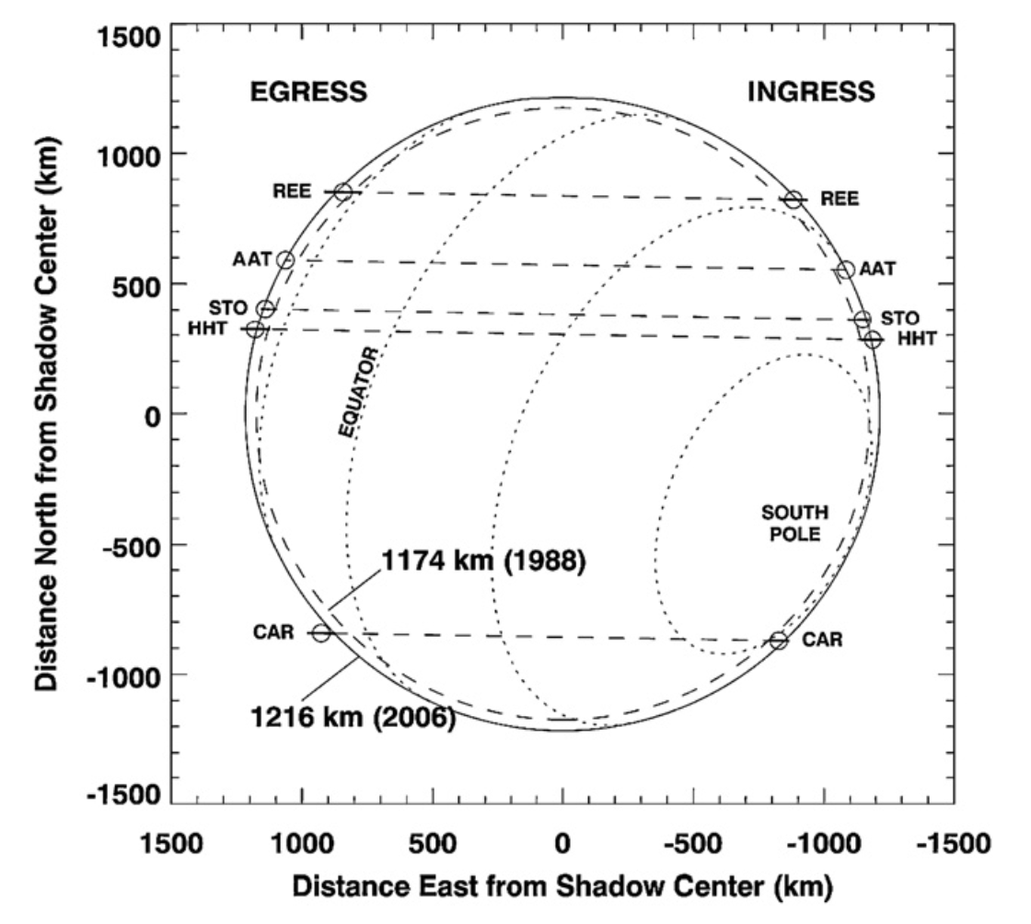
Ground-based Stellar Occultations
Young+2008, AJ, 136, 1757.
Part 1: what we think we know
Notes:
factor of insolation ingress and egress

Slide 4
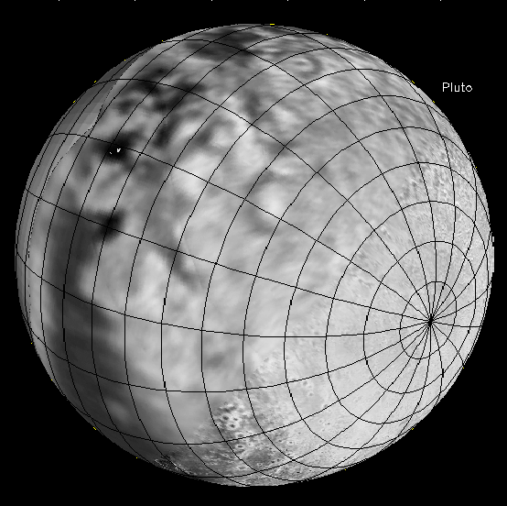
Ground-based Stellar Occultations
50
40
30
Pluto Altitude (km)
20
10
0
Young+2008, AJ, 136, 1757.
Part 1: what we think we know
Notes:
factor of insolation ingress and egress

Slide 5
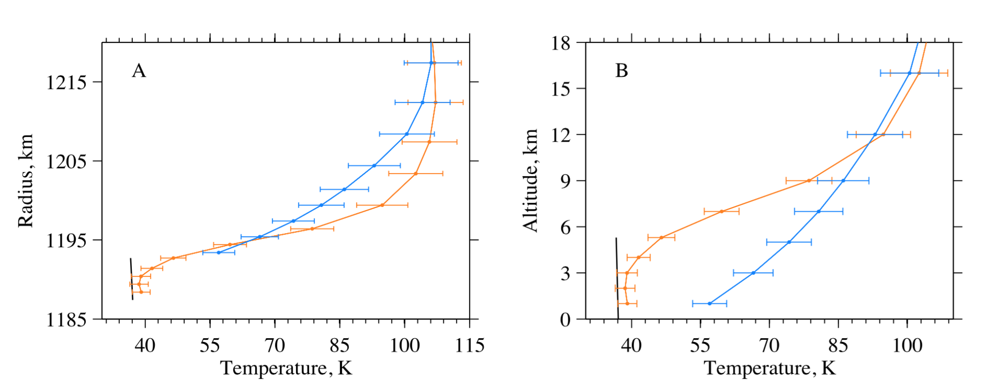
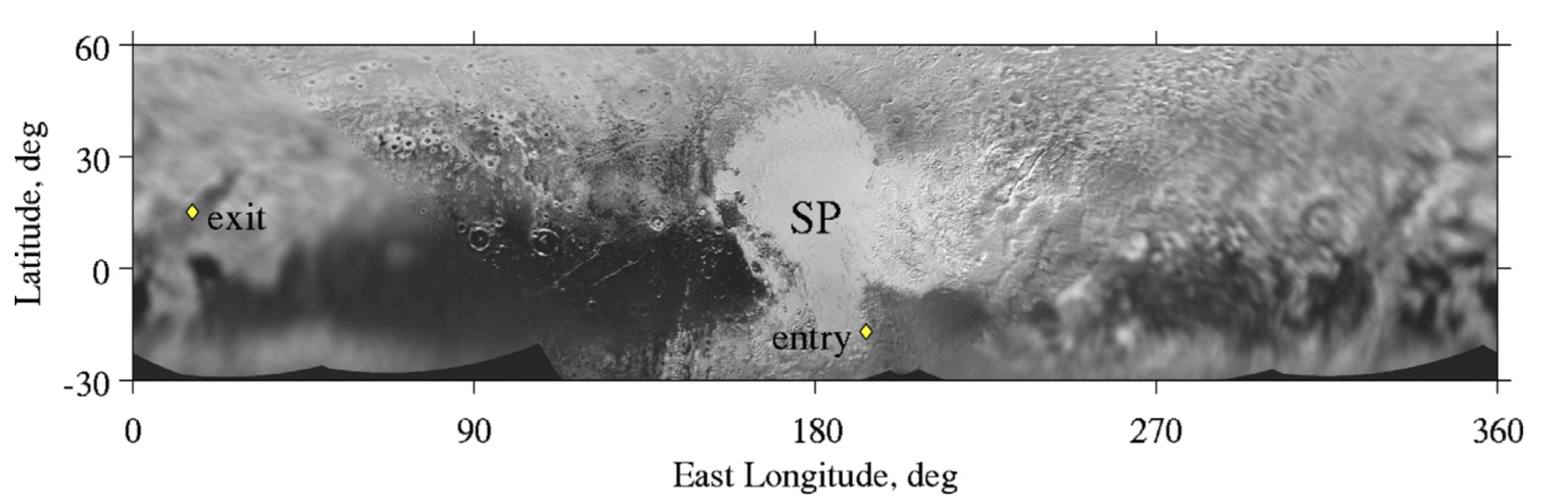
New Horizons Radio Occultation
Hinson+2017, Icarus, 287, 96.
Part 1: what we think we know

Slide 6
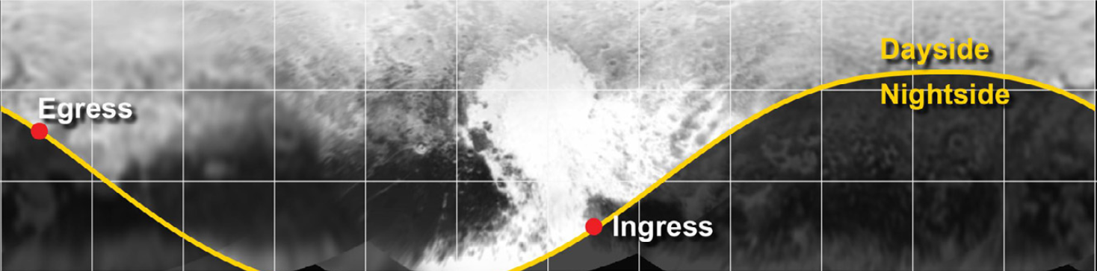
New Horizons Solar UV Occultation
for σ = 10¹⁵ cm⁻²
Young+2018, Icarus, 300,174.
Part 1: what we think we know

Slide 7
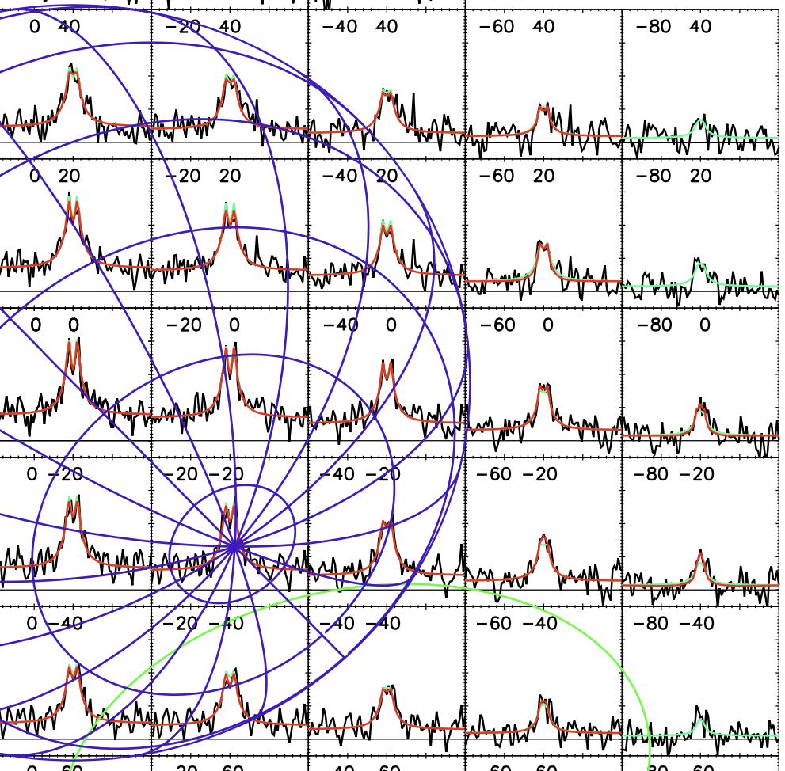
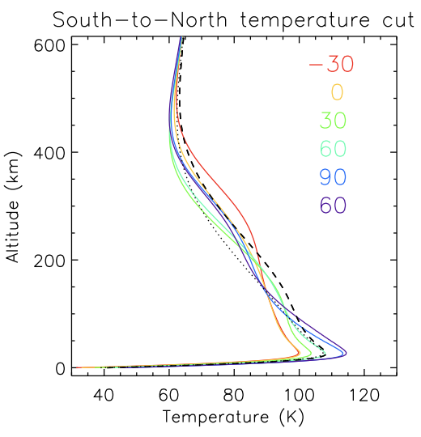
ALMA — Resolved CO and HCN emission
Lellouch+2022, Icarus 372, 114722
Part 1: what we think we know

Slide 8
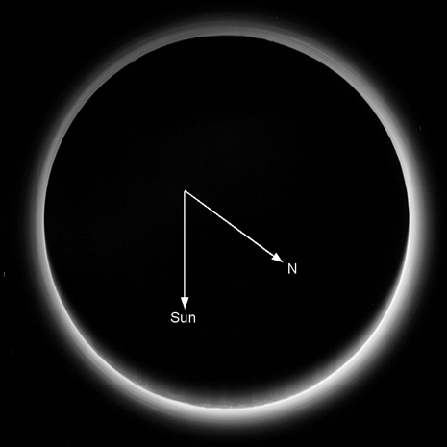
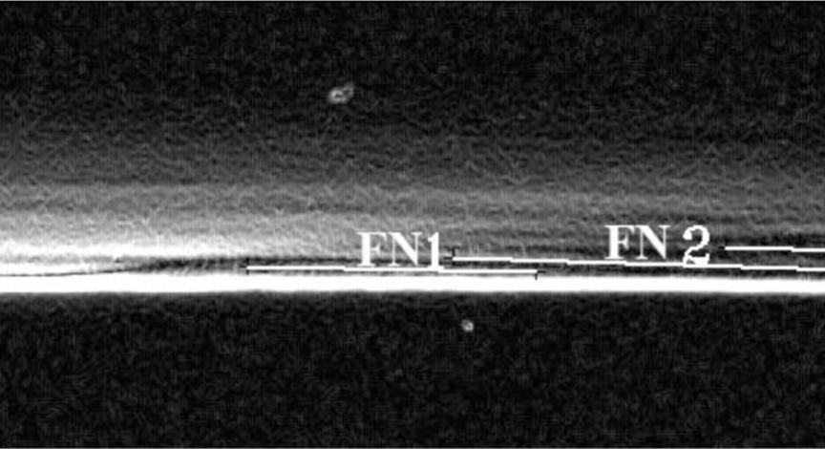
Haze Imaging
Jacobs+2017, Icarus, 290,112.
P_LORRI_FULLFRAME_DEP excerpt, edge filter applied
Cheng+2017, Icarus, 290,112.
Part 1: what we think we know

Slide 9
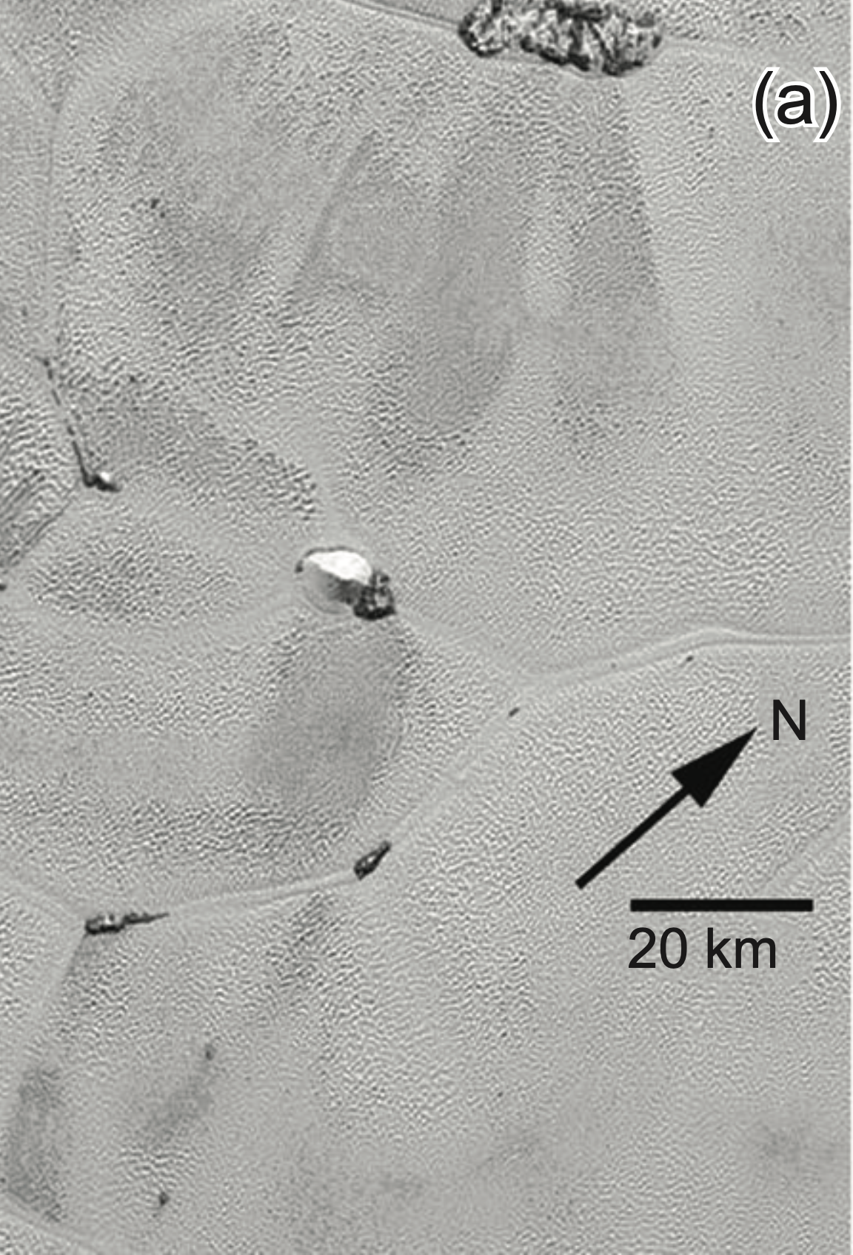
Winds
Don't see
  wind speeds from cloud motion (no confirmed discrete clouds).
  inferred background wind from wave dispersion (no detectable change in haze over 5 hours).
  Doppler shifted lines (IR or radio).
Do see
  Likely wind streaks and dunes in Sputnik Planitia giving clues to surface winds sometime in the last ~0.5 My.
Stern+2017, Icarus 287, 47, Telfer+2018, Science 360, 992, Moore+2021, U of A Book
Part 1: what we think we know

Slide 10
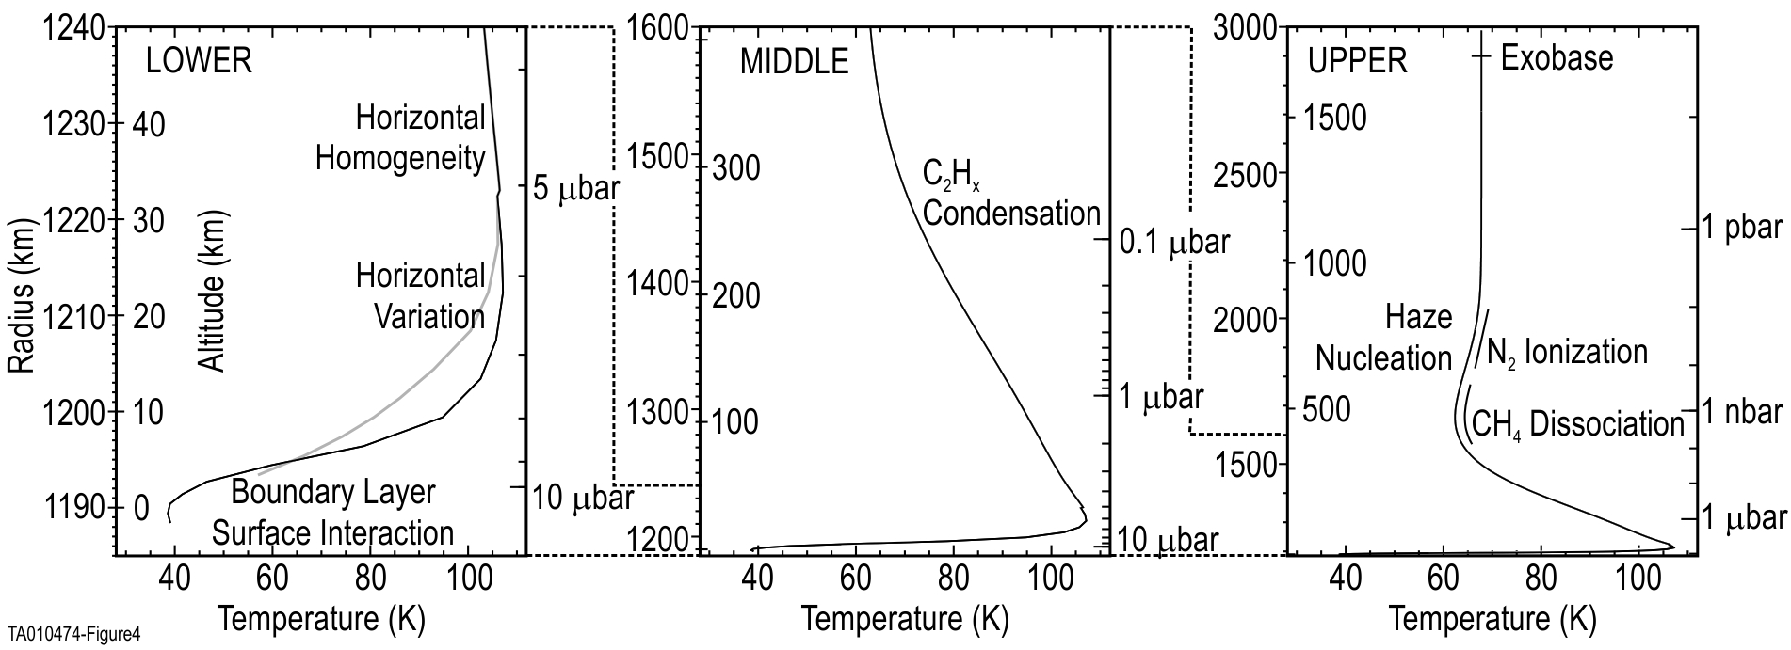
Structure of Pluto's Atmosphere
Longitudinal
Layers (waves?)
updated from Young+2018, Icarus, 300,174.
Part 1: what we think we know
Notes:
Maybe – view of Pluto's

Slide 11
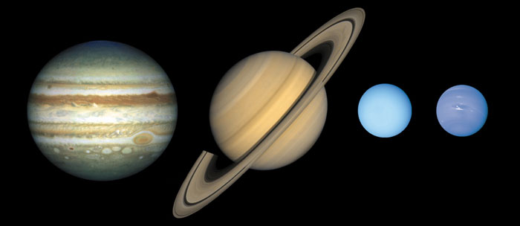
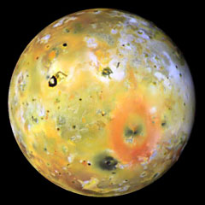
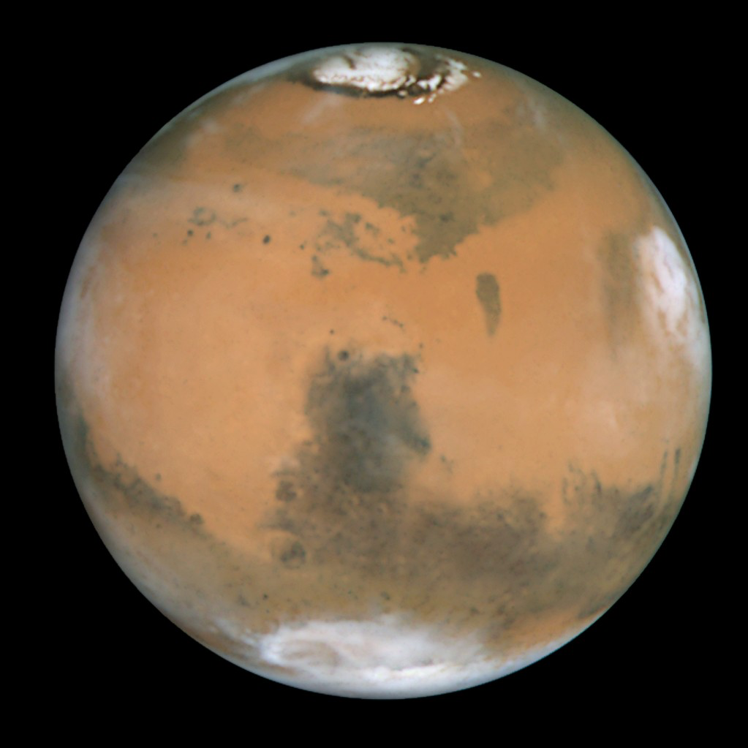
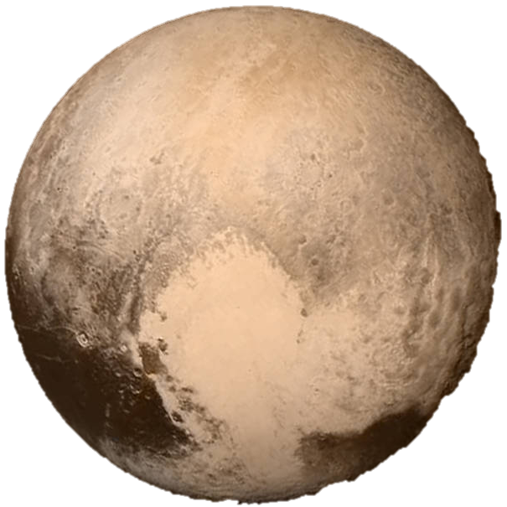
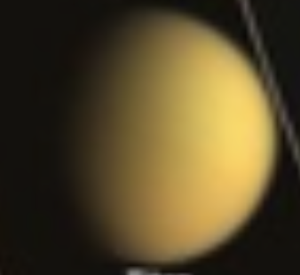
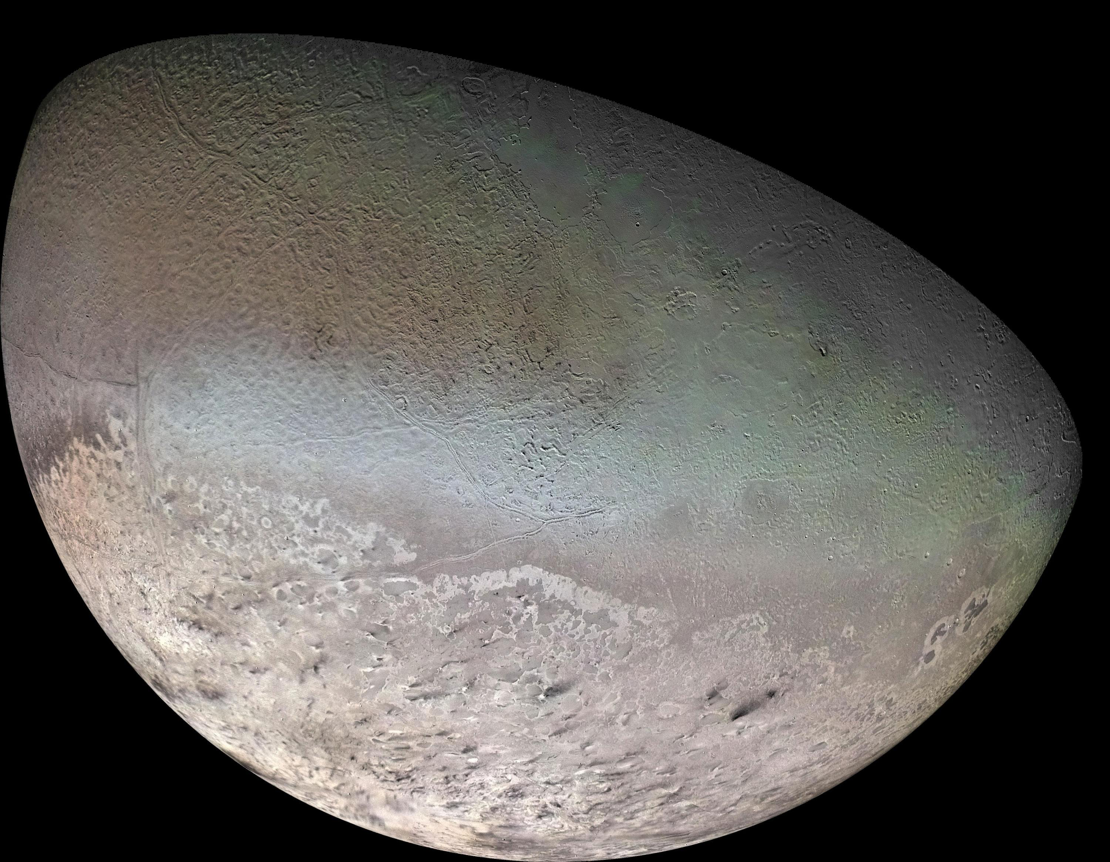
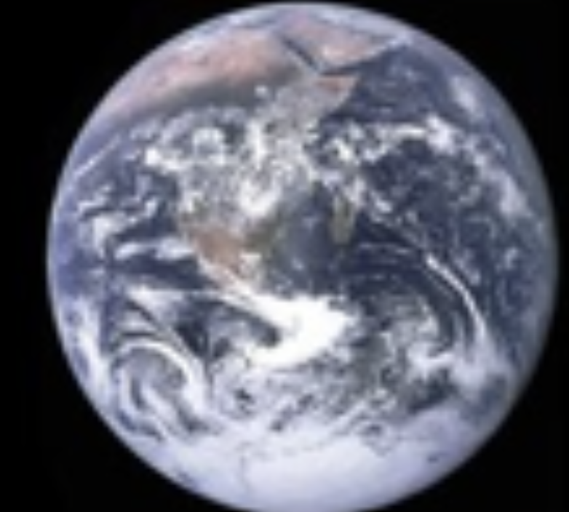
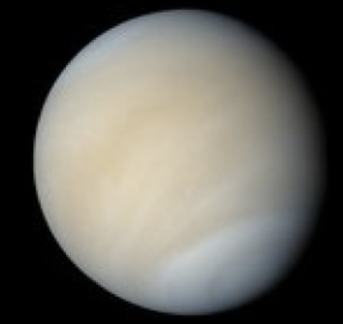
Pluto's Atmosphere
Part 2: Pluto's atmosphere in a solar-system context
Mars-Pluto/Triton-Io-(Eris)
Titan-Pluto-Triton
Earth/Mars-Pluto-Venus/Titan
What we think we know
Notes:
As I was going down to the piraeus yesterday...

Slide 12
Mars-Pluto/Triton-Io-(Eris)
?
Mars
CO₂ & H₂O on surface
and in atmosphere
Surface pressure ~6 mbar
Global atmosphere
Pressure varies
30% per year
(Eris)
CH₄ & inferred N₂
on surface
Atmosphere not detected,
but theorized
Surface pressure (now)
_{f}~1 nbar max???
Local collisional
atmosphere (now)???
Pressure varies
by ~1 million (?) per year
Io
SO₂ on surface
and in atmosphere
Surface pressure
~10 nbar maximum.
Local collisional
atmosphere, supports
atmospheric chemistry.
Pluto & Triton
N₂, CO & CH₄ on surface
and in atmosphere
Surface pressure ~12 µbar
Global atmosphere now
—and all year?
Pressure varies
by x100 (?) per year for Pluto
by x10 (?) per year for Triton?
Part 2: Pluto in context

Slide 13
Sublimation-Supported Atmospheres
Global atmospheres supported
by sublimation (e.g., Mars, current Pluto, current Triton, maybe Gonggong/2007 OR₁₀ and Eris at perihelion) have surface pressures set by insolation on all the volatiles.
Ballistic atmospheres (e.g., Iapetus) and local, collisional atmospheres (Io, maybe current Eris) can still have volatiles moving to cold-traps.
Young&McKinnon+2013, DPS.
Part 2: Pluto in context

Slide 14
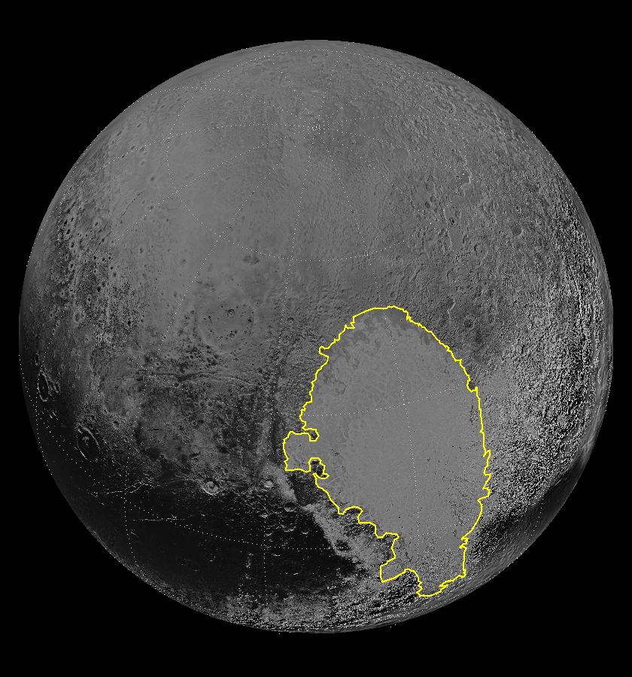
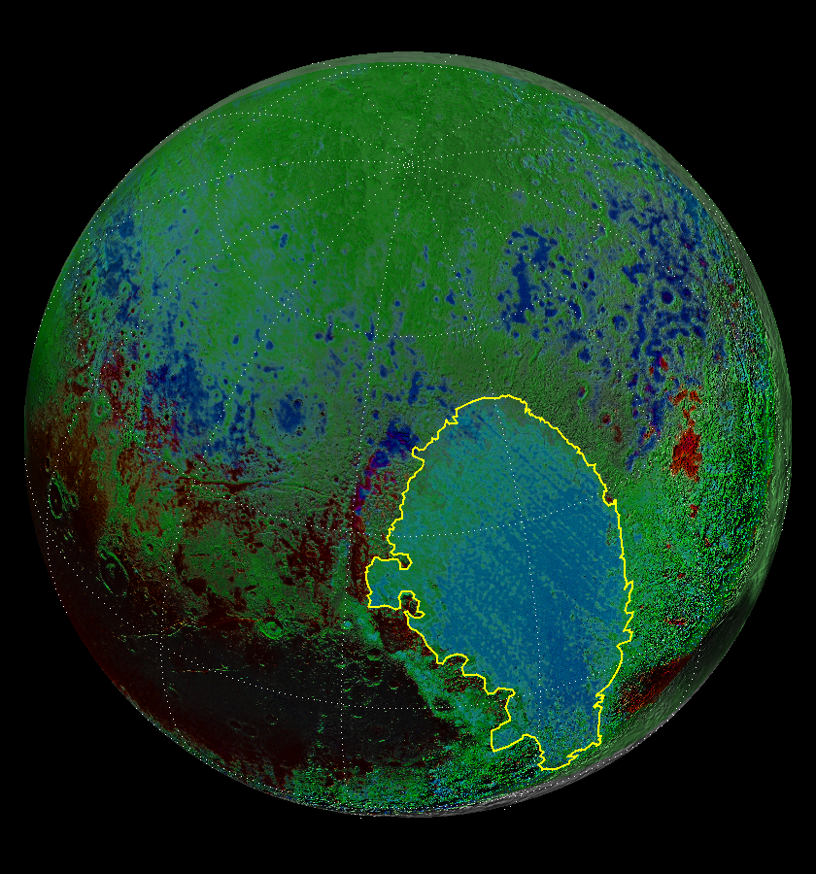
Pluto's Surface
Sputnik Planitia
Equator
Reflectance
Composition N₂ CH₄ H₂O
Young+2021, U of Az Book, from Schmitt+2017, Icarus 287, 229, Protopapa+2017, Icarus 287, 218, Earle+2018 Icarus 314, 195
Part 2: Pluto in context
Notes:
Point out North and the Equator

Slide 15
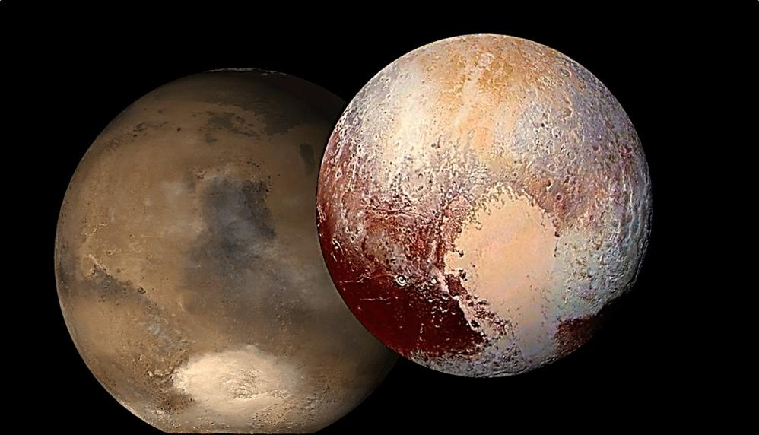
Volatiles Reservoirs in Depressions
Pluto
N₂ ice in
Sputnik Planitia
(~10 km deep)
Mars
CO₂ ice in
Hellas basin
(~8 km deep)
Part 2: Pluto in context

Slide 16
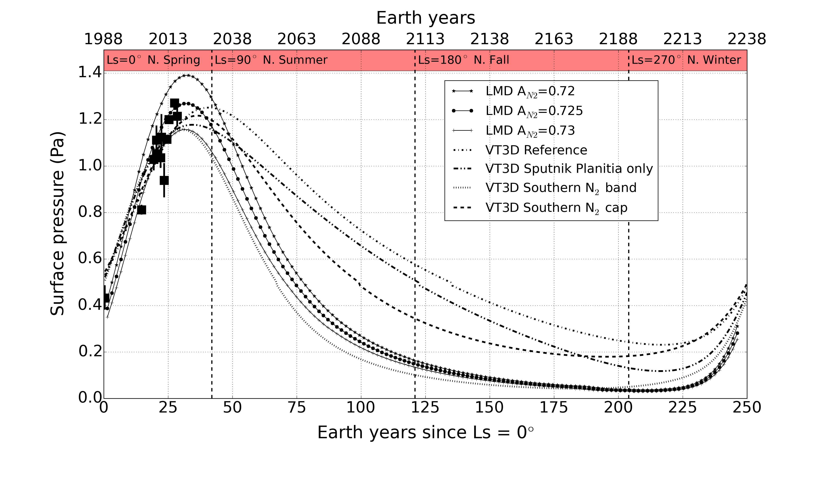
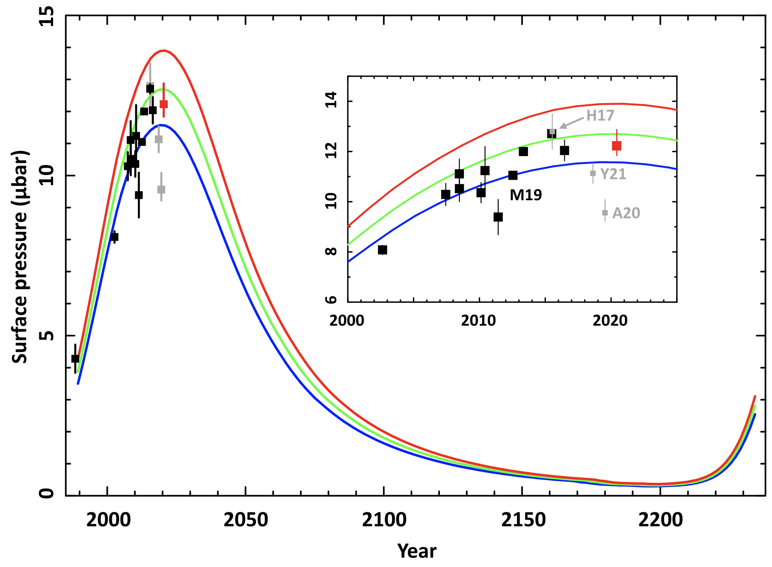
Modeling Surface Pressure over one Pluto Year
Perihelion
Aphelion
N Summer Solstice.
S Summer Solstice.
Sicardy+2021, ApJL, 923, L31. See Meza+2019, A+A 625, A42, Young+2021, U of A Book
Part 2: Pluto in context

Slide 17
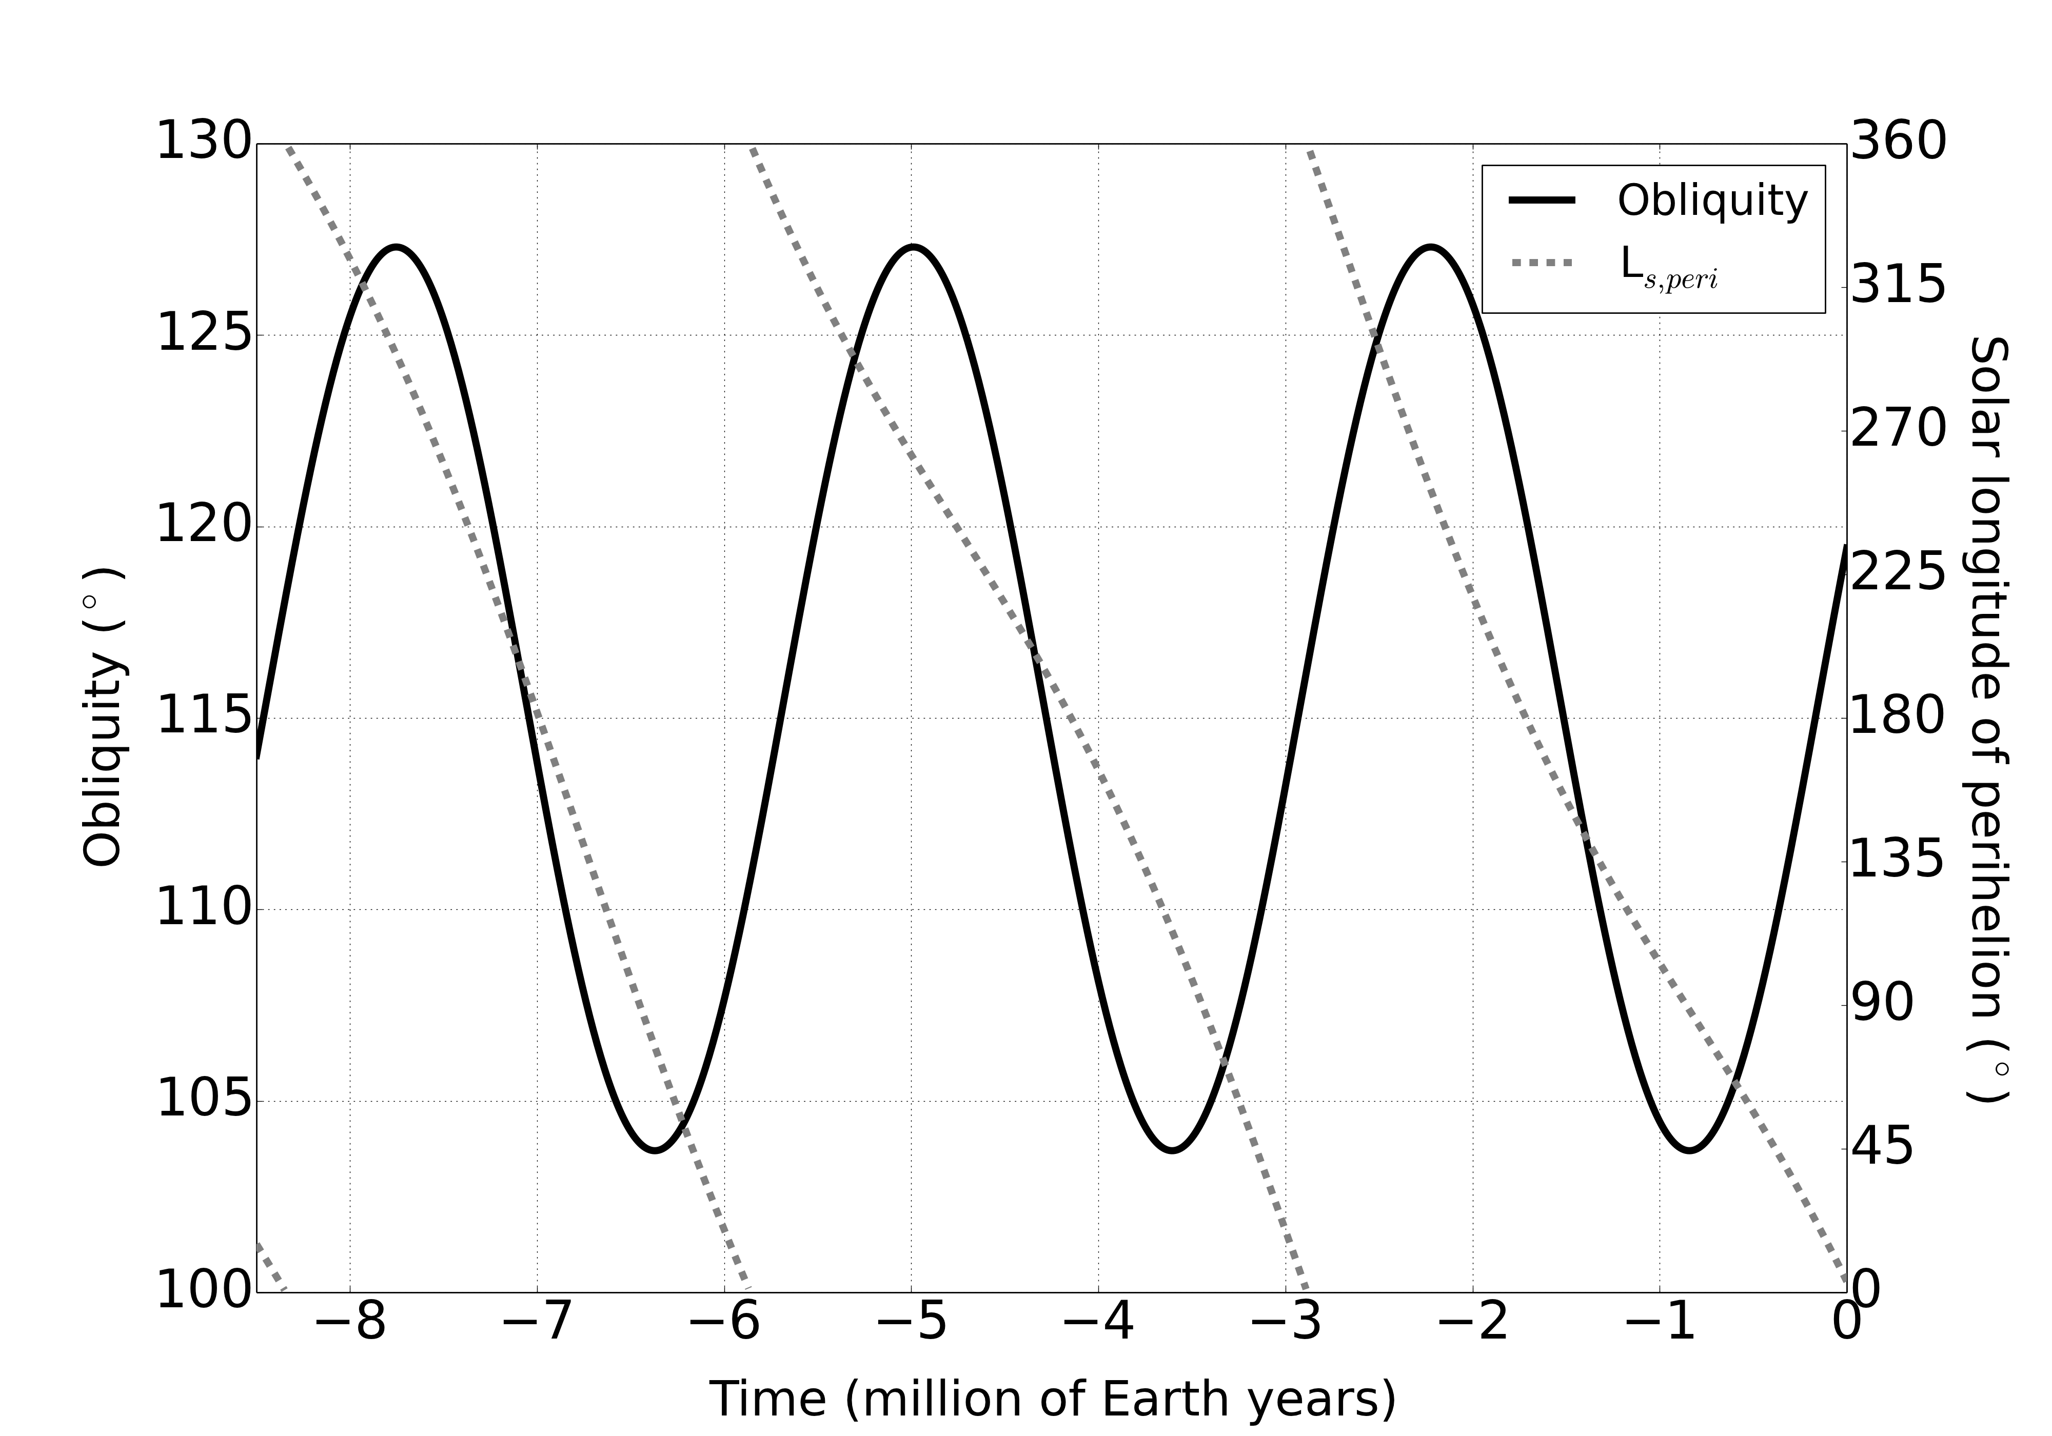
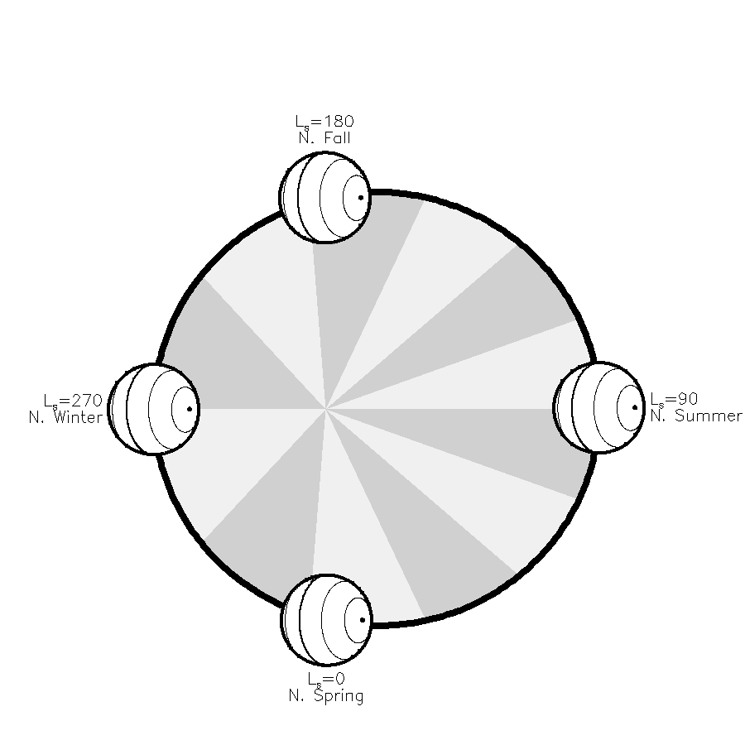


Pluto's Megaseasons
2.4 My ago
Northern Winter at perihelion
Long mild summers
Highest minimum pressures
N₂ moves from Sputnik's center
S. seasonal CH₄?
0.9 My ago
Northern summer at perihelion
Short, intense summers
Lowest minimum pressures
N₂ moves to Sputnik's center
N. seasonal CH₄?
Current
Northern spring at perihelion
Equal N. and S. summers
Bertrand+2019, Icarus 329, 148
Johnson+2021, Icarus 356, 114070
Young+2021, U of A Book
Part 2: Pluto in context
Notes:
duration of obl. cycles

Slide 18
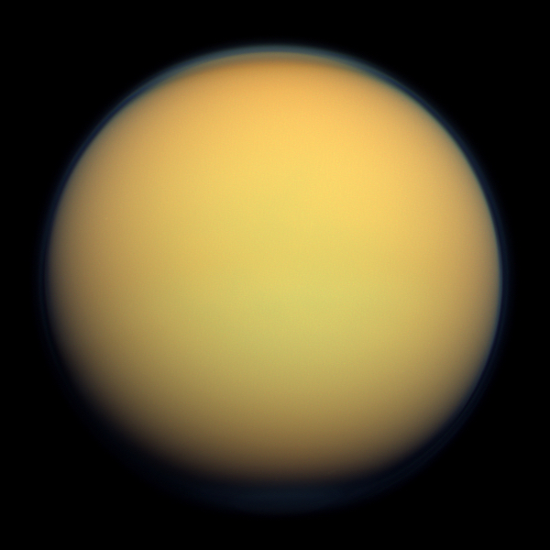
Titan-Pluto-Triton
Titan
N₂ dominant
Surface pressure ~1.5 bar
CH₄ minor species
5.6% at surface (~1.5 bar)
1.5% to 1.2% 80-500 km
increases above ~1000 km
Pluto
N₂ dominant
Surface pressure ~12 µbar in 2015
CH₄ minor species
0.3% at surface (~1.5 bar)
increases above ~400 km
Triton
N₂ dominant
Surface pressure ~14 µbar in 1989
CH₄ minor species
0.01% at surface (~1.5 bar)
decreases to few ppm at 40 km
Part 2: Pluto in context

Slide 19
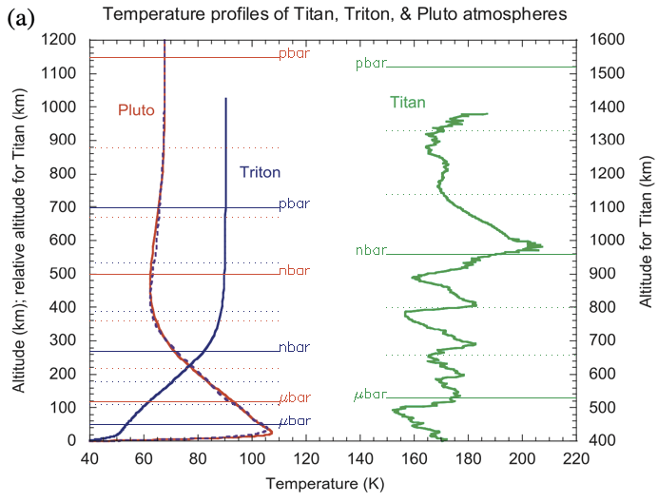
Temperatures & Energetics
Pluto
Colder-than expected
upper atmosphere
Haze might explain
both heating and cooling.
Extremely stable
lower atmosphere
Zhang+2017, Icarus 228. 301. Figure adopted from Strobel&Zhu+2017, Icarus 291, 55.
Part 2: Pluto in context

Slide 20
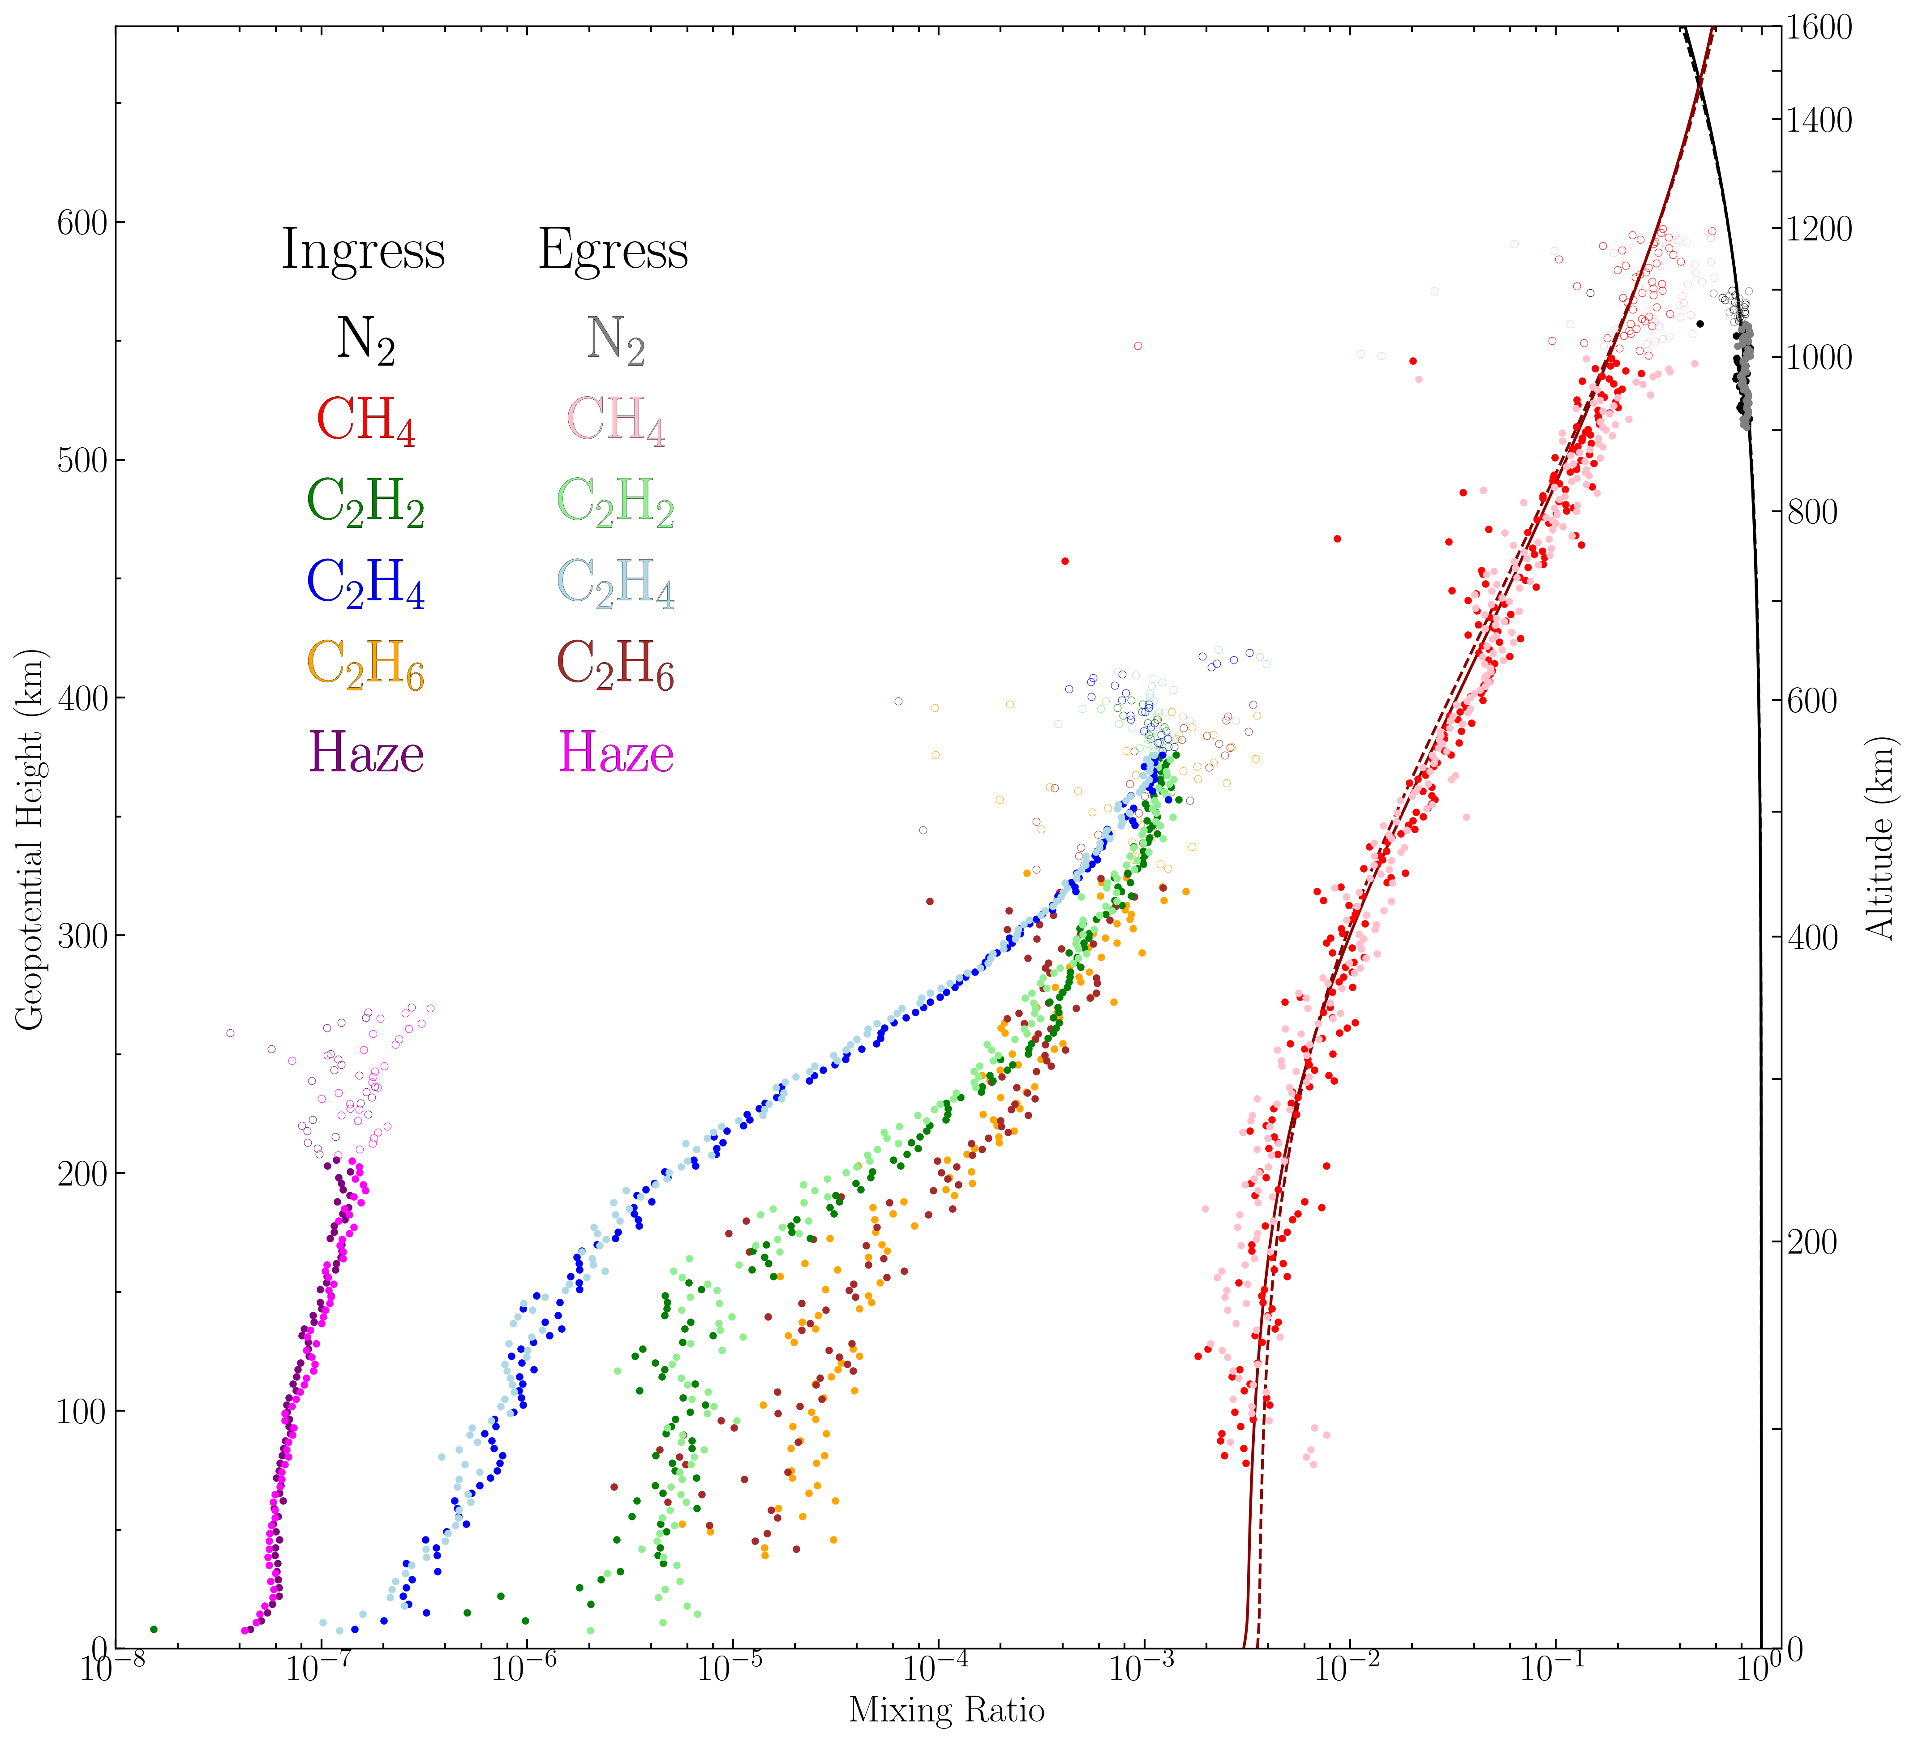
Titan vs. Pluto vs. Triton Photochemistry
Titan has gaseous CO₂,
Pluto and Triton do not.
Titan and Pluto have copious CH₄
in their upper atmosphere,
Triton does not.
Titan's photochemistry
begins in its ionosphere;
Pluto has no detected ionosphere
(less UV, no Jovian magnetosphere).
Triton's CH₄ photochemistry is
initiated at low altitudes
where condensation also occurs.
for σ = 10¹⁵ cm⁻²
10⁻⁶
^{mixing ratio}
10⁻³
1
Young+2018, Icarus, 300,174. Krasnopolsky 2014, COSPAR, Mandt+2021, U of A book
Part 2: Pluto in context

Slide 21
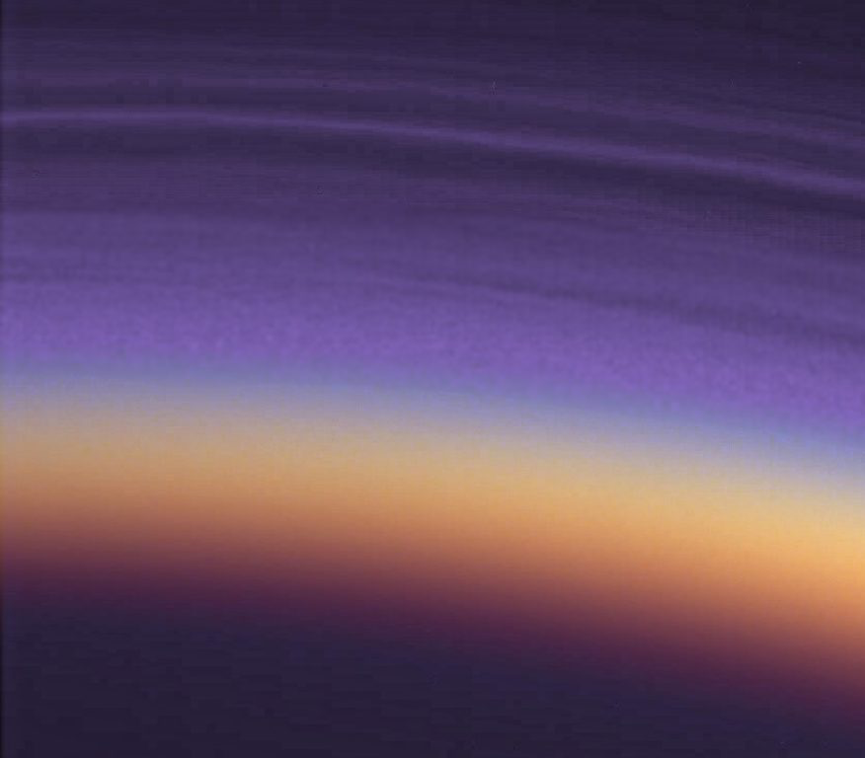

Hazes
Titan
Detached haze layer ~300-520 km
(too high for condensation)
Formation by molecular growth
Pluto
Extended haze to ~200 km
(too high for condensation)
Lavvas+2021: intermediate
Triton
Extended haze to 30 km, and
discrete bright clouds to 4 km.
Formation by condensation
See Mandt+2021, U of A book. Lavvas+2021, NatureAstronomy 5, 289.
Part 2: Pluto in context

Slide 22
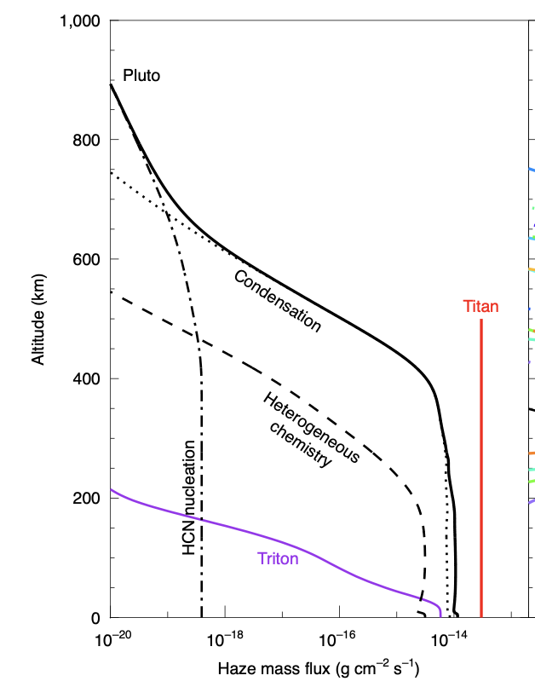
Hazes
Titan
Detached haze layer ~300-520 km
(too high for condensation)
Formation by molecular growth
Pluto
Extended haze to ~200 km
(too high for condensation)
Lavvas+2021: intermediate
Triton
Extended haze to 30 km, and
discrete bright clouds to 4 km.
Formation by condensation
See Mandt+2021, U of A book. Lavvas+2021, NatureAstronomy 5, 289.
Part 2: Pluto in context

Slide 23
Earth/Mars-Pluto-Venus/Titan
Earth/Mars
Fast rotators
Geostrophic balance
Pluto
Intermediate between
fast and slow rotators.
Retrograde? Superrotation?
It depends on how the transport within
Venus/Titan
Slow rotators
Cyclostrophic balance
Super-rotation
Part 2: Pluto in context

Slide 24
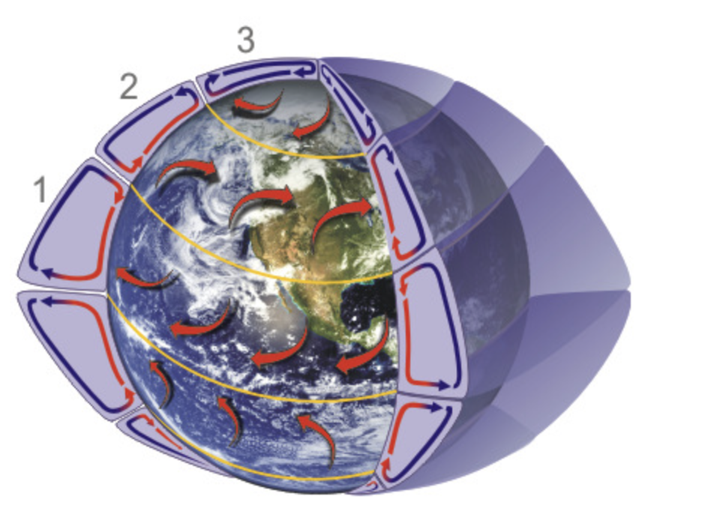
Earth/Mars-Pluto-Venus/Titan
Earth/Mars
Fast rotators
Geostrophic balance
Pluto
Intermediate between
fast and slow rotators.
Retrograde? Superrotation?
It depends on how the
transport within Sputnik Planitia
Venus/Titan
Slow rotators
Cyclostrophic balance
Super-rotation
Part 2: Pluto in context

Slide 25
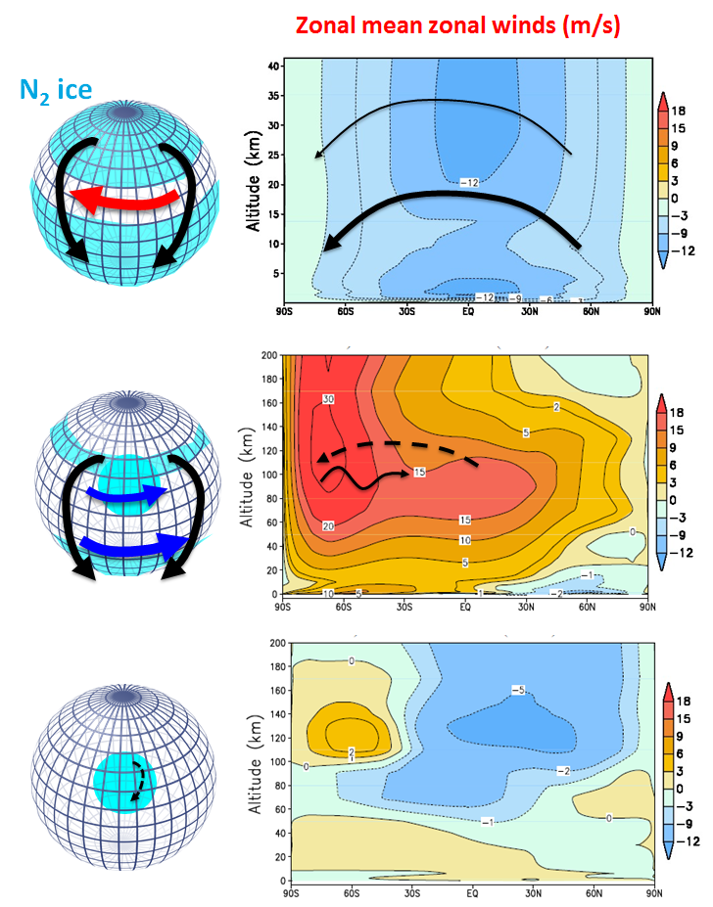
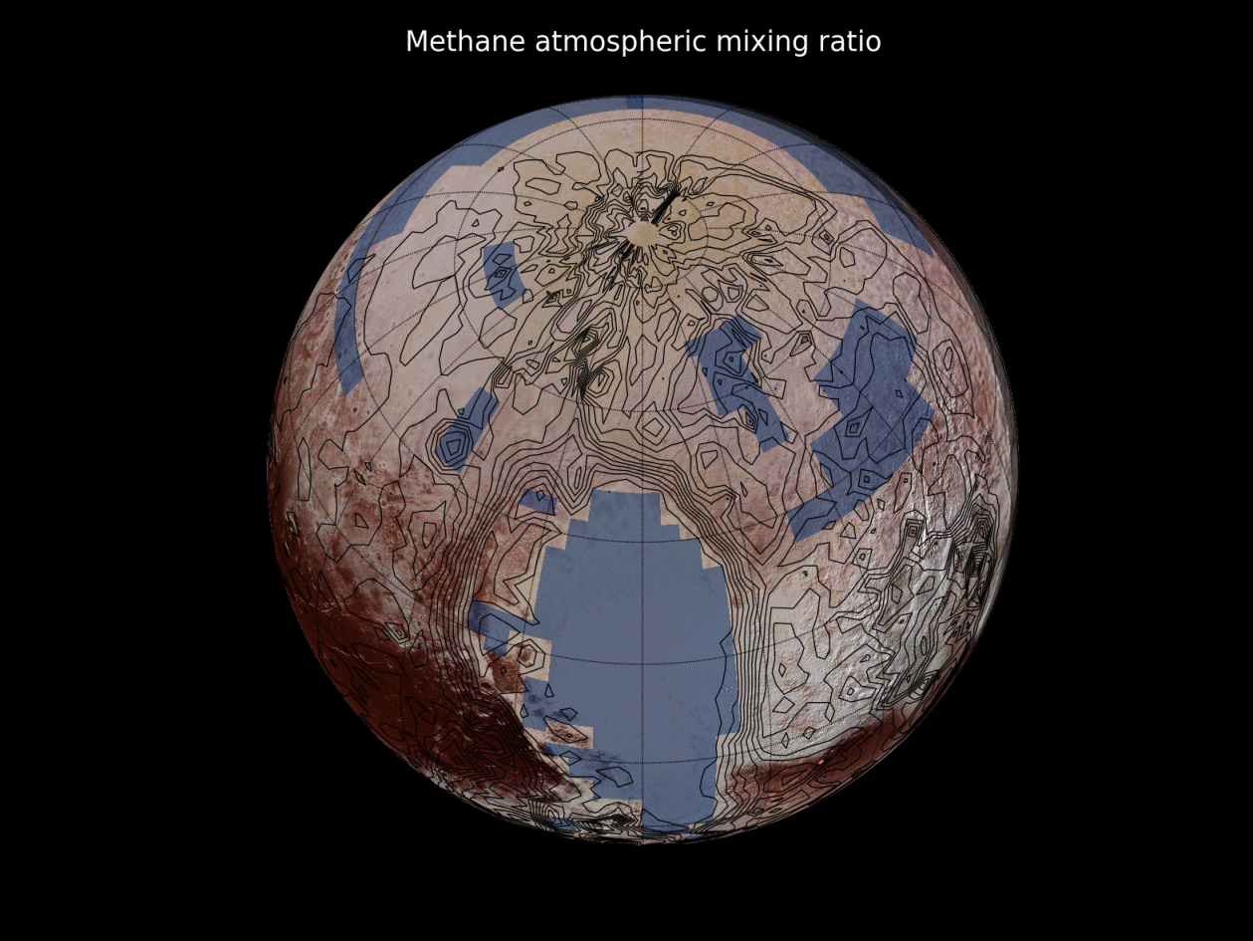
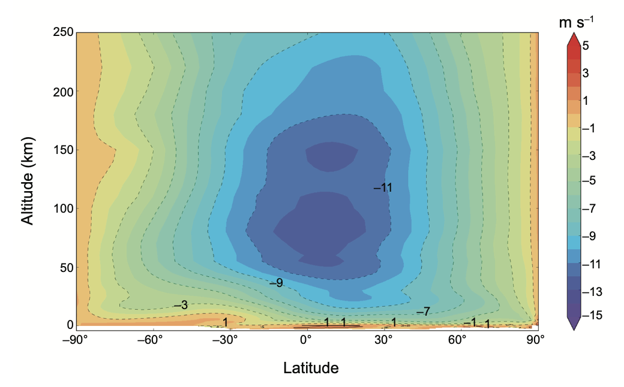
N₂ Distribution Drives Global Circulation
N₂ ice
Most Recent: Retrorotation
N₂ sublimation-condensation flow.
Open circulation cells
(no return branch)
Flow from the
northern to the southern latitudes
Forget+2017, Icarus 287, 54.
Bertrand+2020_JGR_125_E006120; See Forget+2021, U of A book.
Part 2: Pluto in context

Slide 26
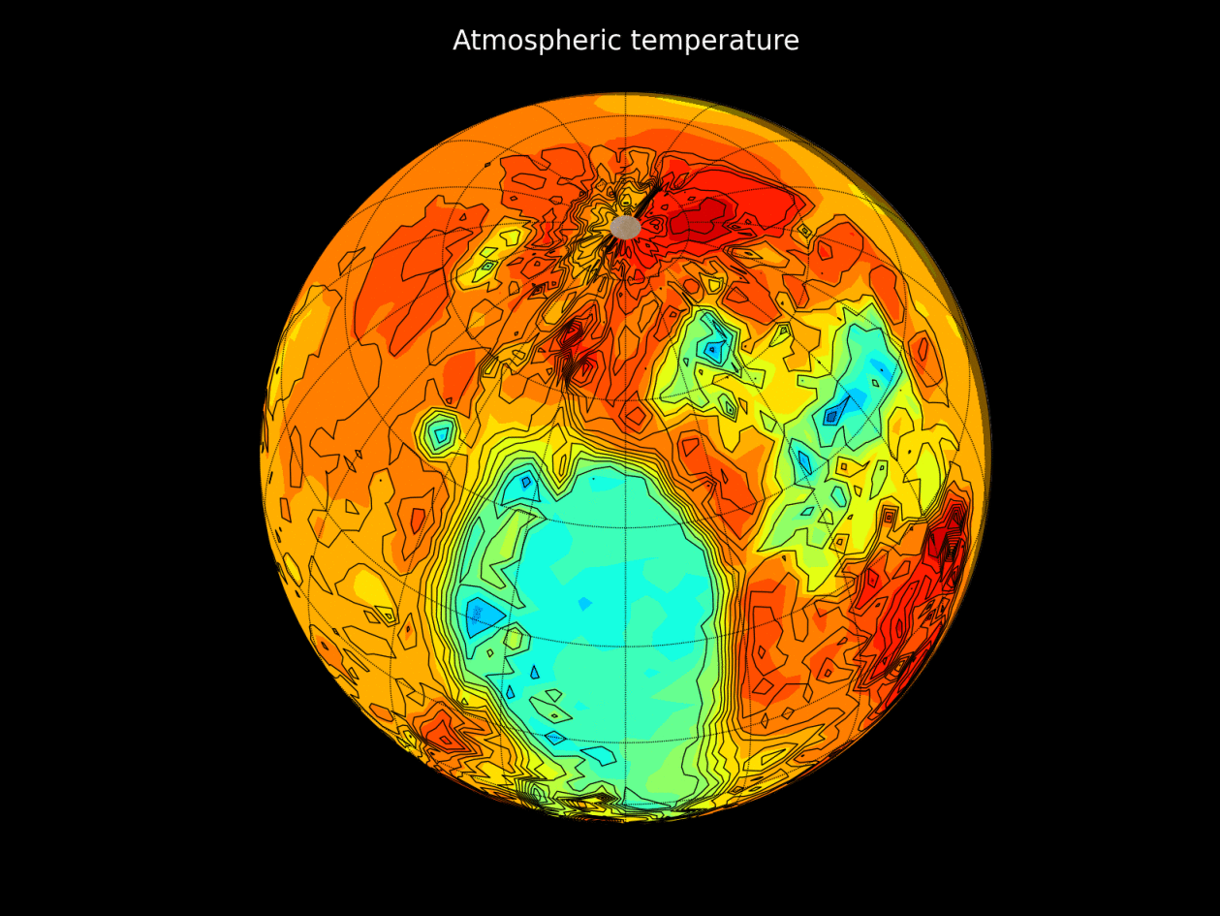
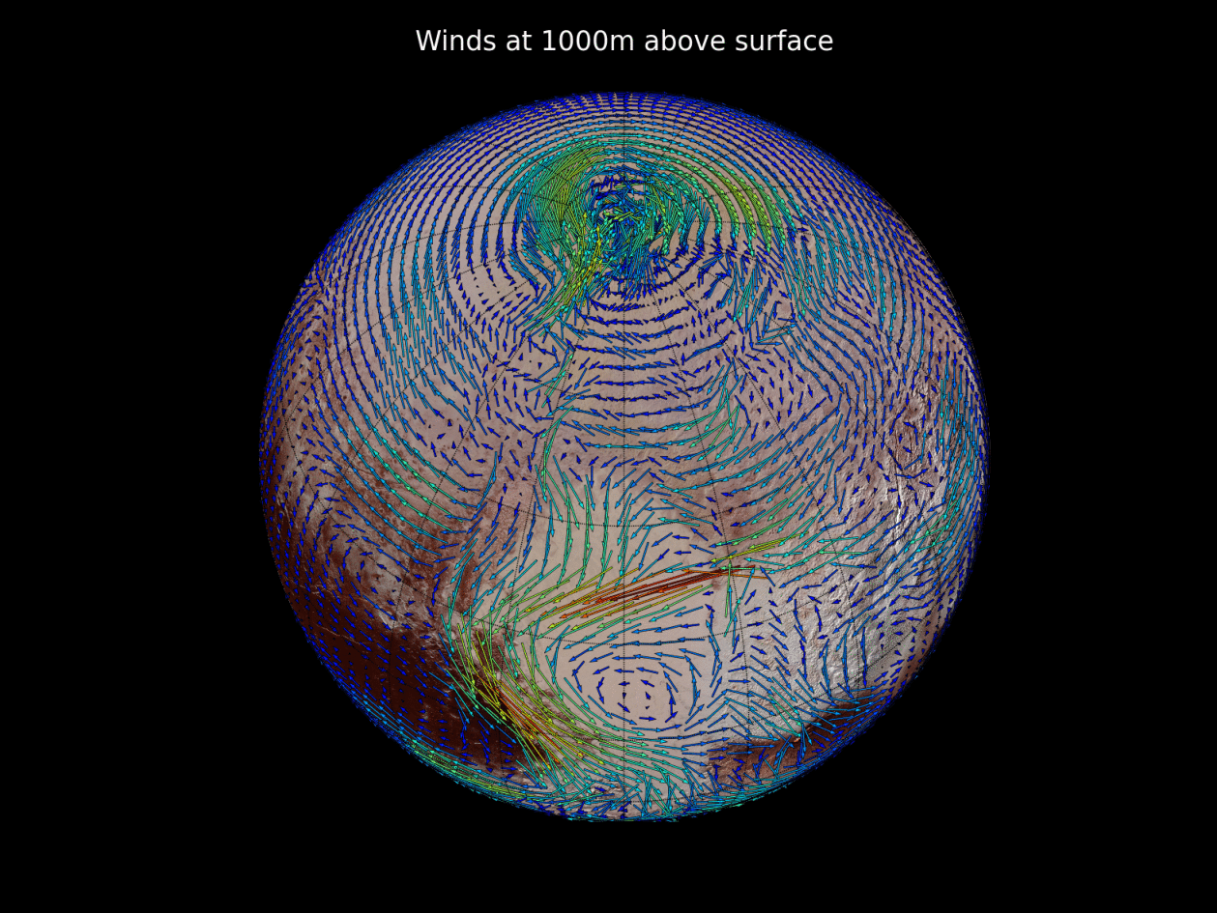



Global Circulation and Sublimation Flow
temperature at 1 km
Sputnik Planitia injects cold N₂ air into the atmosphere during daytime
winds at 1 km
Western boundary current
Bertrand+2020_JGR_125_E006120; Forget+2021, U of A book.
Part 2: Pluto in context

Slide 27
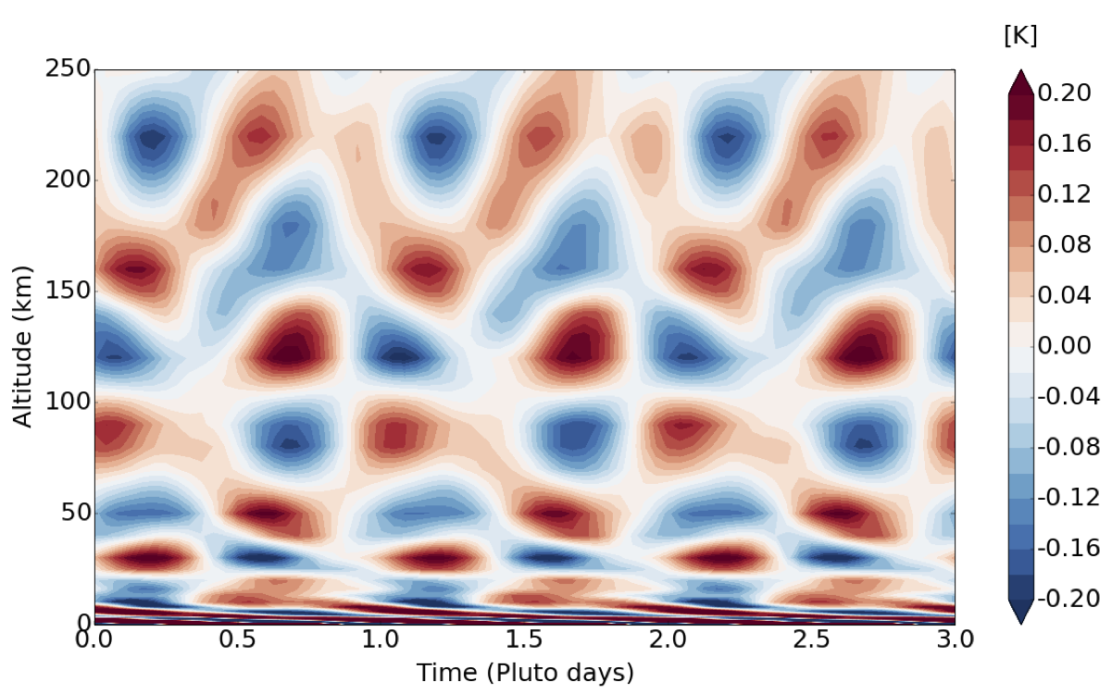
Diurnal Thermal Tides
Bertrand+2020_JGR_125_E006120; Forget+2021, U of A book.
Part 2: Pluto in context

Slide 28
Pluto's Atmosphere
Part 3: Conclusions
What do we want to understand?

Slide 29
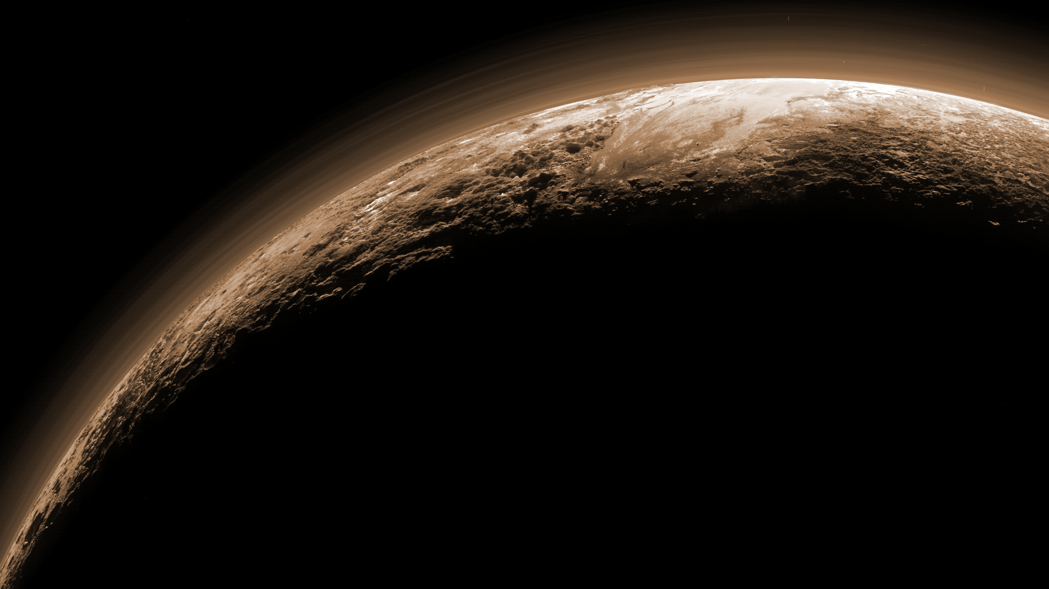
Some Favorite Atmospheric Surprises
Cold Upper Atmosphere
  Slow Escape
  Rethinking Atmospheric Energetics
Sputnik Planitia
Haze
  Ubiquitous
  North-South Gradient
  Layered
Volatile Transport
  Role of perennial deposits
  Glacial Flow
  Solid State Convection
Topography
  Stability of N₂, CH₄
  Surface winds
Role of Megaseasons
  Obliquity cycles
  Growth of perennial deposits
Low Homopause
Part 3: Conclusions

Slide 30
Some Open Questions
Cold Upper Atmosphere
  Escape vs. time
  Is haze really the coolant?
Sputnik Planitia
Haze
  Why isn't Pluto
  coated with haze?
Volatile Transport
  Has the pressure peaked?
  Local variation in gaseous CH₄?
  Surface volatile changes?
Topography
  Triton is flat. Does latitude
  control surface composition?
Role of Megaseasons
  Signature of climate zones
  on other bodies?
Low Homopause
  Role of upward CH₄ flux.
Part 3: Conclusions

Slide 31
Resources
Planetary Data Systems
  Small Bodies Node
This Talk & its Citations
  Just ask me for a copy
University of Arizona Book
  30% off with code AZFLR
Leslie Young
  layoung@boulder.swri.edu
Part 3: Conclusions

